Slide 1
Esophageal caner -Preoperative evaluation and staging-
서울대학교병원
강 창 현

Slide 2
NCCN ESOPH-1

Slide 3
NCCN ESOPH-2

Slide 4
Medical Fitness for Esophagectomy
Risk assessment
Age
Functional status
Cardiac function
Respiratory function
Nutritional status
Socioeconomic status
Other treatment options
CCRT / RT / Palliation

Slide 5
ECOG (Eastern Cooperative Oncology Group) performance status
Grade | ECOG
0 | 무증상
1 | 증상이 있으나 완전한 거동이 가능한 상태
2 | 증상이 있으며 침대에서 50% 이하 머무는 상태
3 | 증상이 있으며 침대에서 50% 이상 머무는 상태
4 | 완전한 침대생활
5 | 사망

Slide 6
Interdisciplinary approach
Surgeon
Cardiologist
12-lead EKG
Echocardiography
Optimization of medication (HT, HF, arrhythmia)
Tx of coronary obstruction (PCI, CABG)
Pulmonologist
PFT, ABGA
Mucolytics, bronchodilators, respiratory therapy

Slide 7
Evaluation and mamagement of Heart problem (AHA guideline 2007)
Patients with DOE
should undergo evaluation of LV function
Patients with 1 risk factor of coronary disease, known CHD, peripheral arterial disease or cerebrovascular disease
12-lead ECG
Patients with 3 or more risk factors and poor functional capacity
Noninvasive stress test

Slide 8
Evaluation and mamagement of Heart problem (AHA guideline 2007)
Stable angina with left main disease, 3-vessel disease, 2-vessel disease with significant proximal LAD stenosis
High risk unstable angina
Acute ST-elevation angina
Coronary revascularization before surgery is recommended

Slide 9
Evaluation and mamagement of Heart problem (AHA guideline 2007)
In patients who are undergoing preparation for PCI and who are likely to require invasive or surgical procedures within the next 12 months, consideration should be given to implantation of a baremetal stent or performance of balloon angioplasty with provisional stent implantation instead of the routine use of a DES.

Slide 10
Nutrition
Preopreative chemoradiation
Cytotoxic agents (cisplatin, 5-FU)
Nausea, vomitting, diarrhea, mucositis, and anorexia
Radiation
Mouth and thoroat soreness, difficulty swallowing, fatigue, and anorexia
Nutritional support
Weight gain after completion of chemoradiation
Nutrition monitoring and evaluation
Nutrition intervention
Content, frequency, amount, IV or tube feeding
Nutrition education (esp. for the patients with dysphagia)

Slide 11
Feeding and Nutrition
Oral feeding in case of no dysphagia
Nutrition modification in mild dysphagia
Severe dysphagia
L-tube feeding
J-stomy feeding
Esophageal stent
PEG (usually not recommended for surgical candidates)

Slide 12
Presentation
Incidentally detected
Dysphagia
Odynophagia
Anorexia
Weight loss
Hoarseness
Chest pain
Vomiting, Reflux
Supraclavicular or cervical lymphadenopathy

Slide 13
Evaluation
H&P
Upper GI endoscopy and biopsy
CBC and chemistry
Bronchoscopy (above carina)
Chest/abdominal CT (contrast)
EUS (FNA if indicated)
PET-CT

Slide 14
Upper GI endoscopy
Location
Degree of obstruction
Longitudinal / Circumferential extent
Biopsy

Slide 15
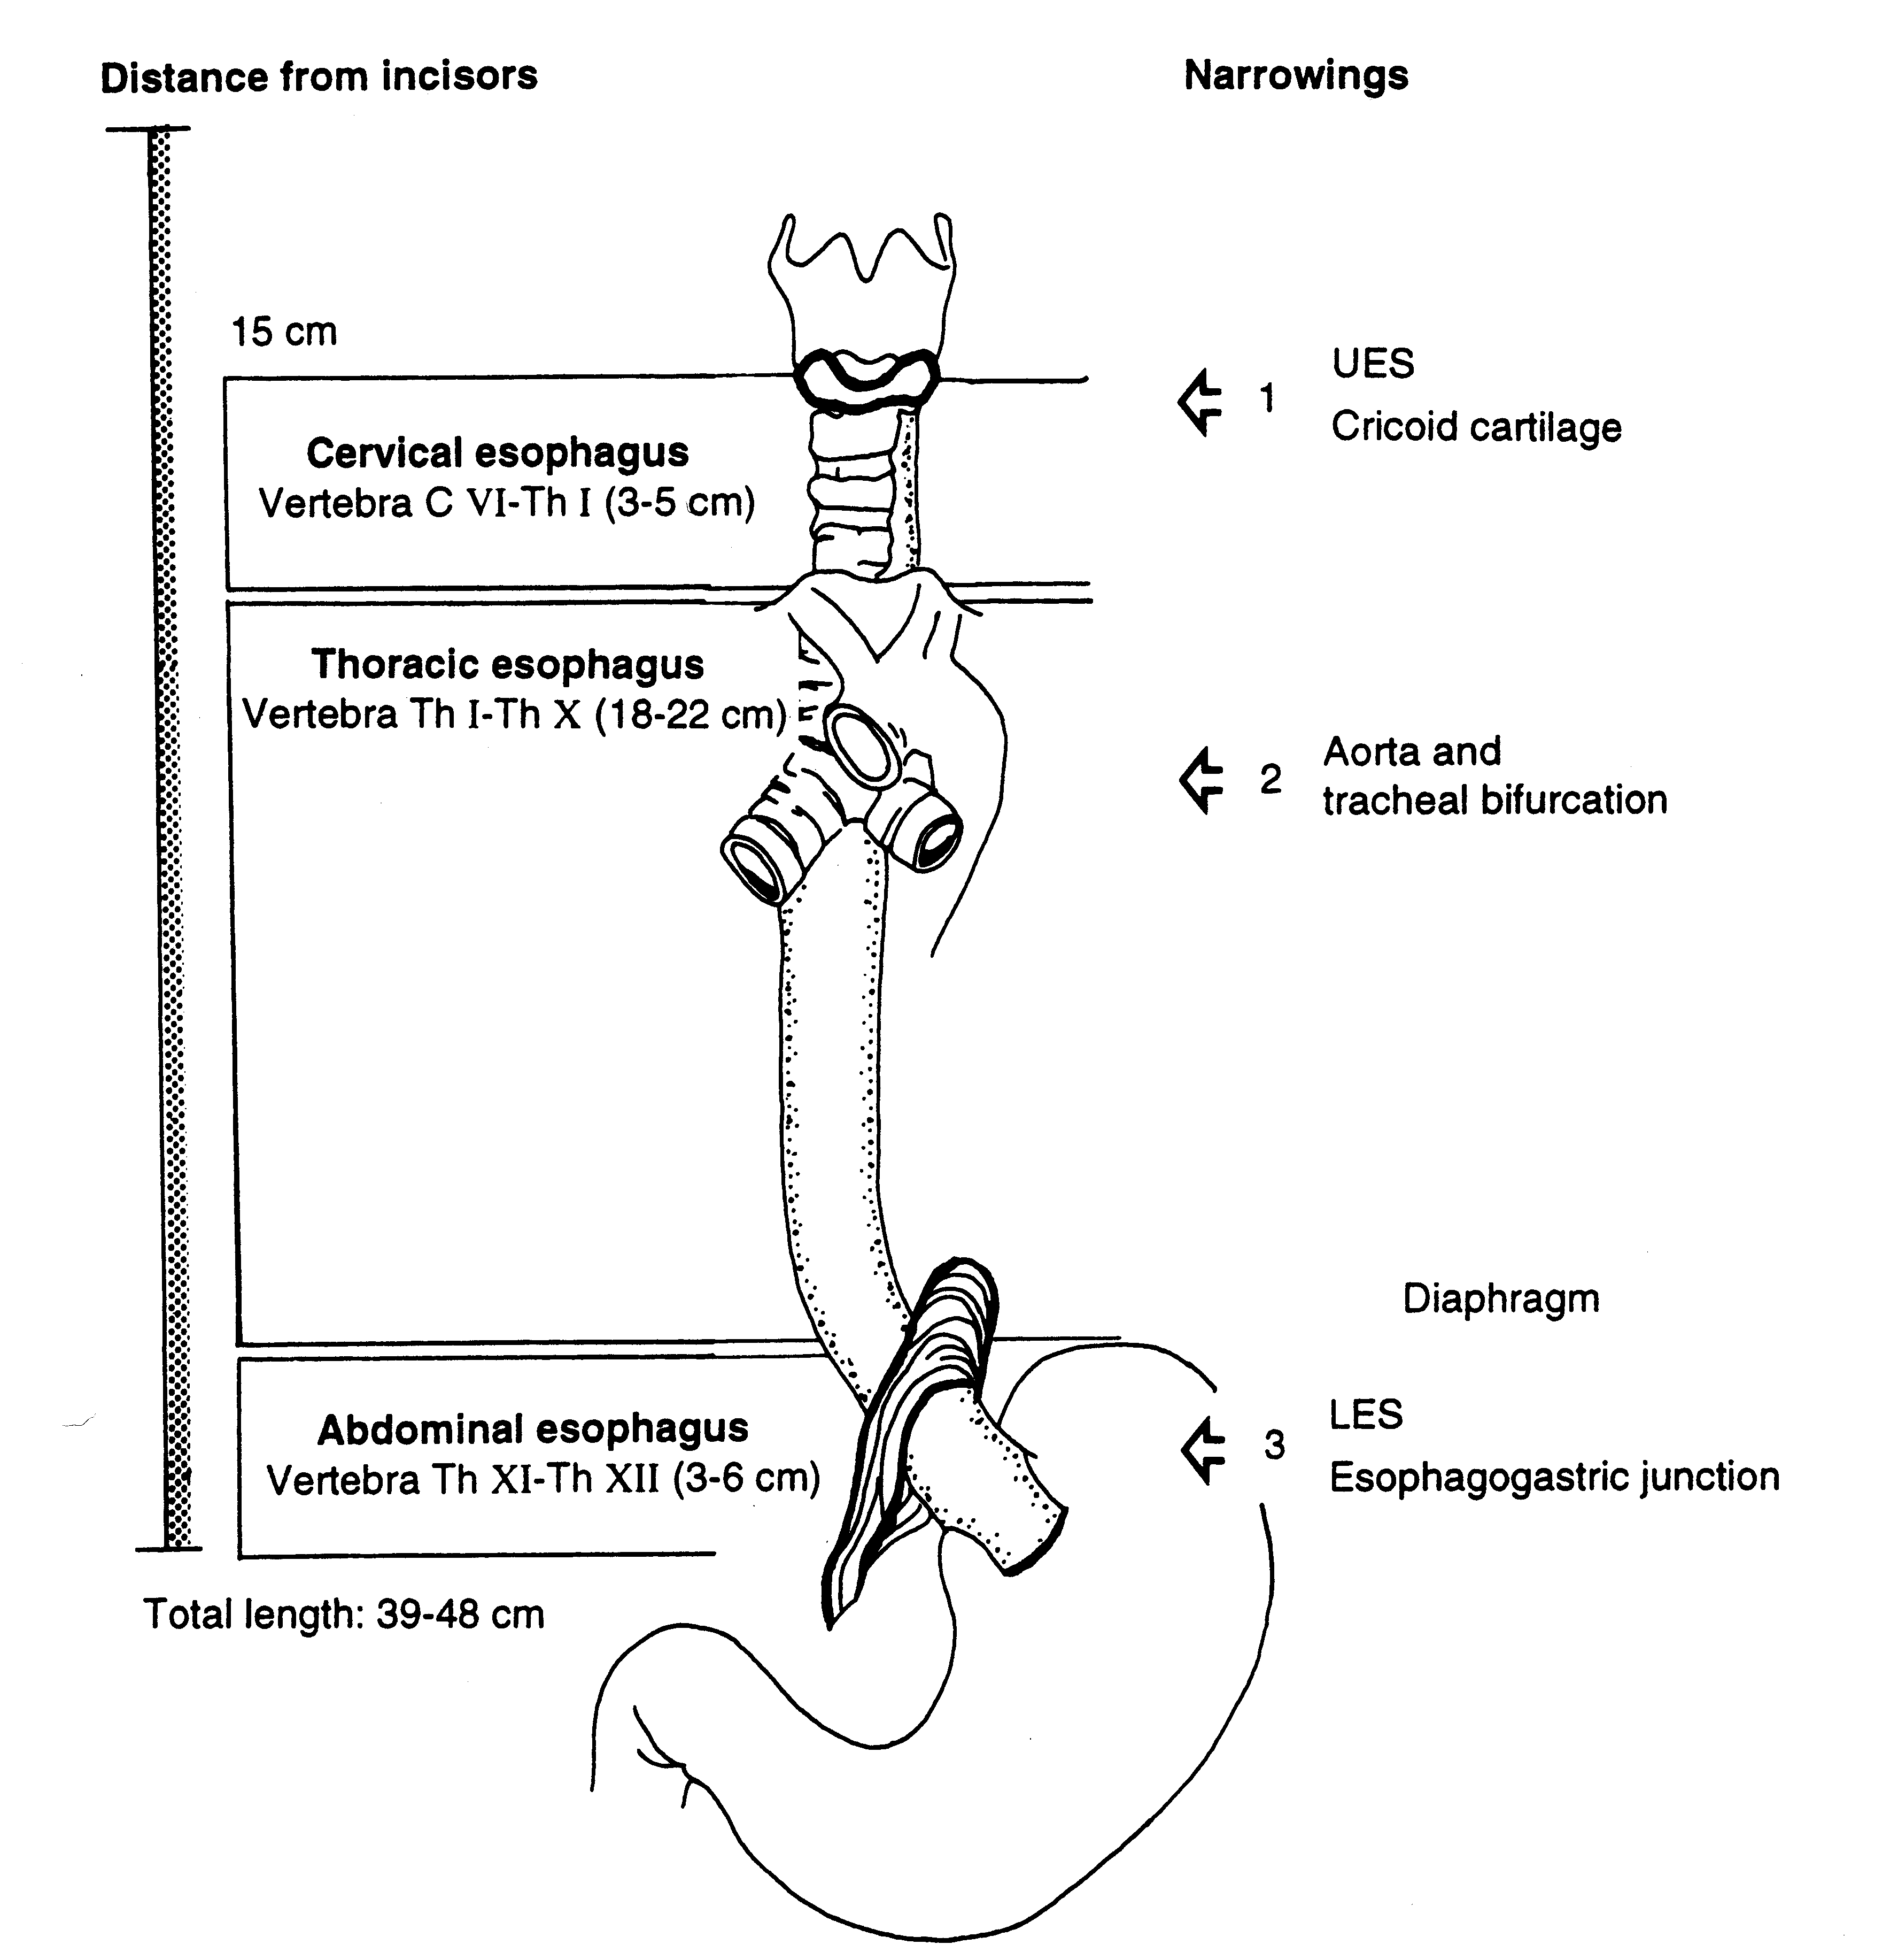

Slide 16
Primary sites of esophageal cancer
Anatomic Name | Location | Anatomic boundaries | Location
Cervical | Upper | Hypopharynx to sternal notch | 15 to <20cm
Thoracic | Upper | Sternal notch to azygos vein | 20 to <25cm
 | Middle | Lower border of azygos vein to inferior pulmonary vein | 25 to <30cm
 | Lower | Lower border of inferior pulmonary vein to esophagogastric junction | 30 to <40cm
Abdominal | Lower | Esophagogastric junction to 5cm below esophagogastric junction | 40 to <45cm
 | EG junction /cardia | Esophagogastric junction to 5cm below esophagogastric junction | 40 to <45cm

Slide 17
Staging modalities
EUS is the best method for the depth of tumor
However, 30% of patients has severe stenosis
At least a T3
Chest CT
Mediastinal or adjacent organ invasion
PET-CT
Poor sensitivity for small volume tumor
Sensitivity for Dx of cancer
T1 43%, T2 90%, T3 98%, T4 100%

Slide 18
EUS
EUS is the best method for the depth of tumor
T staging
Accuracy 84~89%
N staging
80% accuracy
Better in celiac than mediastinal
EUS-FNA
98% sensitive
100% specific

Slide 19
EUS T-staging
Acurracy
T1 84% 16% overstaged
T2 73% 17% overstaged 10% understaged
T3 89% 6% overstaged 5% understaged
T4 89% 11% understaged

Slide 20
EUS N-staging
Malignant
Large, round, hypoechoic, nonhomogenous, sharply bordered
Benign
Samll, oval, hyperechoic, homogenous, indistinct bordered
Sensitivity 89%
Specificity 75%
Accuracy 84%
For T3 and T4 cancers, an EUS assessment of N0 does not ensure absence of N1 disease

Slide 21
Bronchoscopy
Evaluation of airway invasion
In cervical / upper / mid thoracic esophageal cancer
Tracheobronchial invasion
Cervical 26/153 (16.9%)
Upper thoracic 82/487 (16.9%),
Trachea: bronchus 6:4
Findings
Bulging, loss of striations, fixation of post wall, tumor invasion, fistula

Slide 22
Chest CT T-staging
T stage
Tis, T1, T2 – not distinguishable
T3 – obliteration of paraesophageal fat
T4 – invading adjacent organs
Aorta invasion – contact of ≥ 90 degree, obliteration of fat plane
Tracheobronchial invasion – inward bowing of trachea, obliteration of fat plane
Pericardial invasion – obliteration of fat plane, pericardial thickening, pericardial effusion, inward deformity of heart
Diaphragmatic invasion – obliteration of fat plane, crural invasion in adenocarcinoma

Slide 23
Chest CT N-staging
Size
Supraclavicular 5 mm
Retrocrural 5 mm
Gastrohepatic ligament 8 mm
Periesophageal 10 mm
Sensitivity
Mediastinal 34~61%
Abdomen 50~76%

Slide 24
PET-CT M-staging
PET-CT
Sensitivity 69%
Specificity 93%
Unexpected distant metastsis by PET
3~37%
Chest CT
Sensitivity 46%
Specificity 74%
Reduce unnecessary surgery by PET-CT
21%

Slide 25
M stage
Common metastatic sites of esophageal cancer
Liver 35%
Lung 20%
bone 9%
kidneys 2%
brain 2%

Slide 26
Staging
AJCC 7th staging

Slide 27
Grouping – general rule
Stage
0 | 전이를 안 하는 상피내암종 (Carcinoma in situ)
I | 임파선 전이가 없는 조기 암
II | 원발병소 진행 / 임파선 전이
III | 원발병소 진행 / 임파선 전이 / 절제 불가능
IV | 원발 장기 전이

Slide 28
Staging

Slide 29
N & M staging

Slide 30
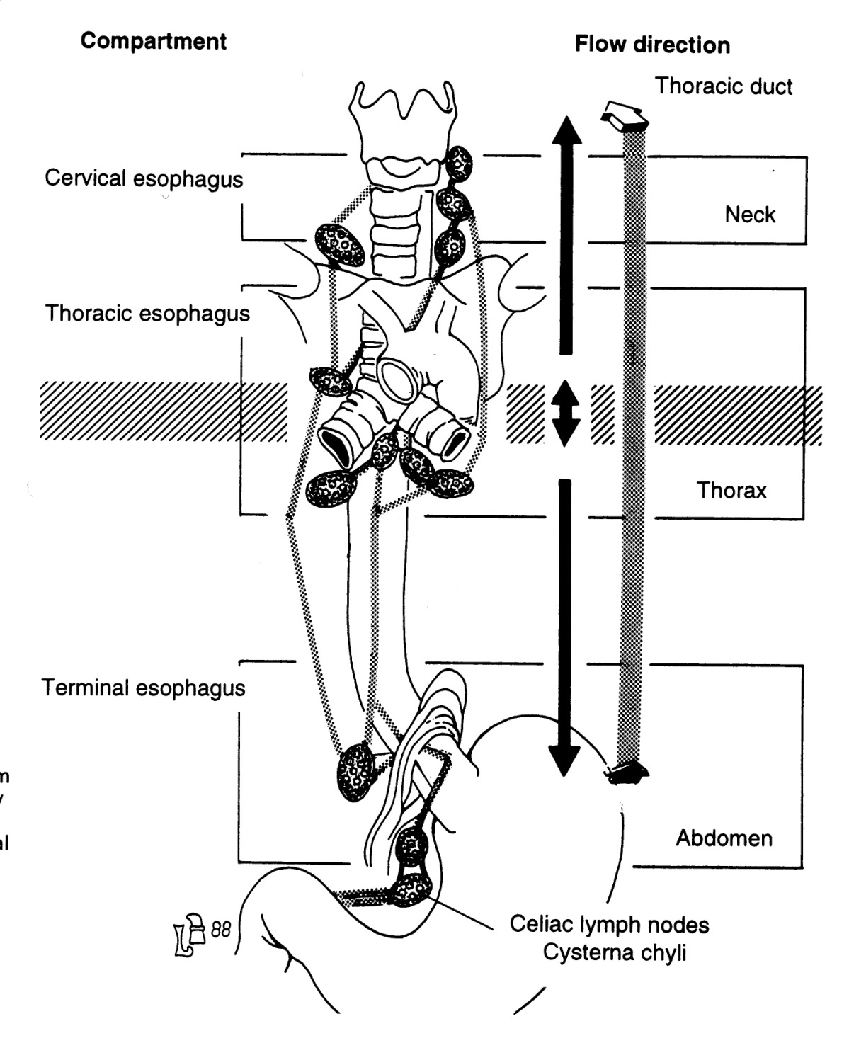

Slide 31
LN maps in esophageal cancer
Number | Name | Location
1, 2R, 4R, 2L, 4L, 3p, 5, 6, 7, 9, 10R, 10L | Same with lung cancer mapping
8M | Middle esophageal | Tracheal bifurcation ~ caudal margin of IPV
8L | Lower esophageal | Caudal margin of IPV ~ GEJ
15 | Diraphragmatic | Dome of diaphragm, adjacent or behind crura
16 | Paracardial | Immediately adjacent to GEJ
17 | Left gastric | Along the course of left gastric artery
18 | Common hepatic | Along the course of the common hepatic artery
19 | Splenic | Along the course of the splenic artery
20 | Celiac | At the base of the celiac artery

Slide 32
Staging (adenocarcinoma)

Slide 33
Stage grouping of adenocarcinoma
Group T N M Grade
0 Tis (HGD) N0 M0 1,X
IA T1 N0 M0 1,2
IB T2 N0 M0 1,2
T1 N0 M0 3
IIA T2 N0 M0 3
IIB T3 N0 M0 Any
T1-2 N1 M0 Any
IIIA T1-2 N2 M0 Any
T3 N1 M0 Any
T4a N0 M0 Any
IIIB T3 N2 M0 Any
IIIC T4a N1-2 M0 Any
T4b Any M0 Any
Any N3 M0 Any
IV Any Any M1 Any

Slide 34
Staging (squamous cell carcinoma)

Slide 35
Stage grouping of squamous cell carcinoma
Group T N M Grade Location
0 Tis (HGD) N0 M0 1 Any
IA T1 N0 M0 1,X Any
IB T1 N0 M0 2-3 Any
T2-3 N0 M0 1,X Lower, X
IIA T2-3 N0 M0 1,X Upper, Middle
T2-3 N0 M0 2-3 Lower, X
IIB T2-3 N0 M0 2-3 Upper, Middle
T1-2 N1 M0 Any
IIIA T1-2 N2 M0 Any
T3 N1 M0 Any
T4a N0 M0 Any
IIIB T3 N2 M0 Any
IIIC T4a N1-2 M0 Any
T4b Any M0 Any
Any N3 M0 Any
IV Any Any M1 Any

Slide 36
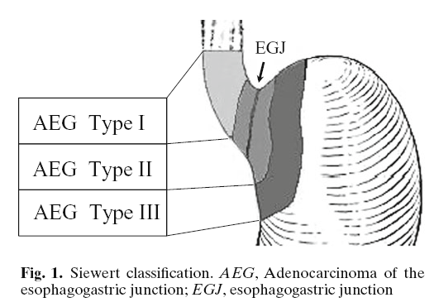
Siewert
Type I

Slide 37
Siewert-Stein classification of GEJ adenocarcinoma
Type | Location of center | GEJ invasion | Incidnence
I | 1-5cm above GEJ | Yes or no | 25%
II | 1cm above and 2cm below GEJ | Yes | 50%
III | 2-5cm below GEJ | Yes | 25%

Slide 38
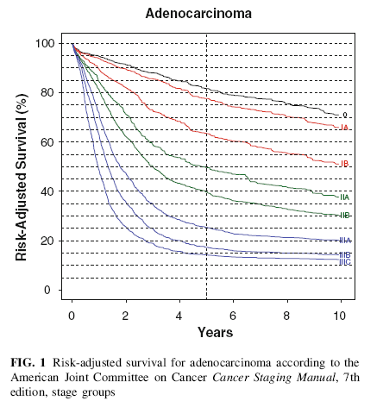

Slide 39
