Slide 1
Preoperative work up for Lung Cancer Surgery
계명대학교 동산의료원
금 동윤

Slide 2
무엇을 확인할 것인가?
환자는 어떤 증상을 호소하는가?
병의 진행 정도는 수술이 합당한가?
환자의 몸 상태는 수술을 견딜 수 있는가?
Clinical presentation on Lung Cancer Patients
Anatomical staging of Lung cancer
Physiologic staging of Lung cancer

Slide 3
Clinical presentation
Symptomatic lung cancer: 95%
27% primary cancer related,
32% metastatic related,
34% non specific
Asymptomatic: 5%
Caustic factor: stage at presentation
tumor anatomic location
tumor histology
tumor biology

Slide 4
Dyspnea
Cough
Pulmonary
manifestations
Hemoptysis
Wheezing
Atelectasis
Pneumonic symptoms
Pneumonia
Lung abscess

Slide 5
Phrenic nerve paralysis
Dyspnea
Pleura/Pericardial effusion
Pneumothorax
Nonpulmonary
thoracic
manifestations
Pleuritic?
Chest pain
Localized?
Radicular?
SVC syndrome
Pancoast syndrome
Voice change
Dysphagia
Back pain

Slide 6
Pancoast syndrome←Superior sulcus tumor
Shoulder pain← direct invasion of rib and muscle
Radicular arm pain ← invasion of C8/T1 nerve root of brachial plexus
Horner’s syndrome(enophthalmos, ptosis, miosis,anhidrosis by satellite ganglion invasion)

Slide 7
Joint pain
Paraneoplastic
syndromes
Clubbing
Muscular weakness
Bone pain
Metastatic
manifestations
Neurologic symptoms
Weight loss

Slide 8
Anorexia
Nonspecific
manifestations
Fatigue
Weight loss

Slide 9
TNM staging

Slide 12
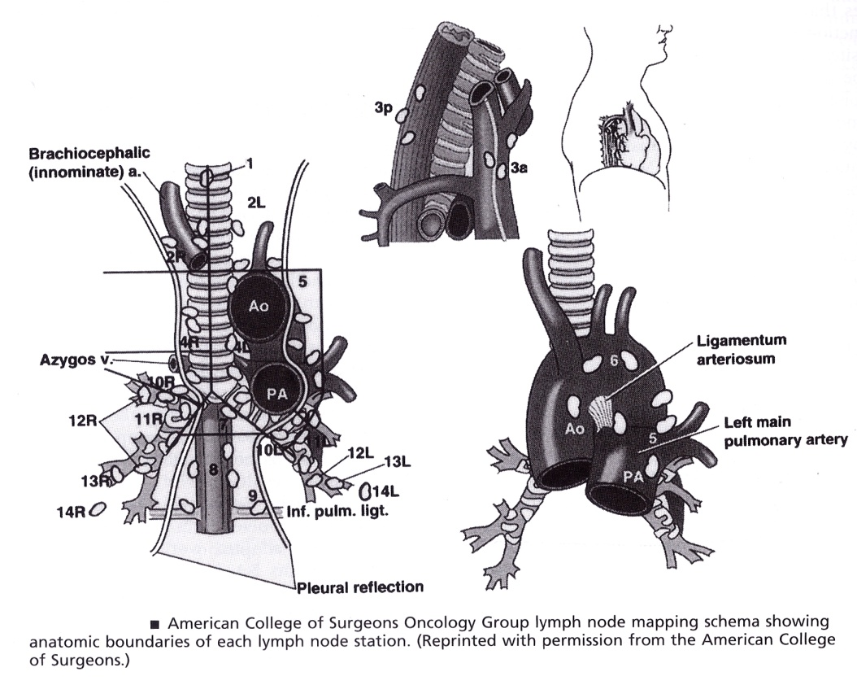
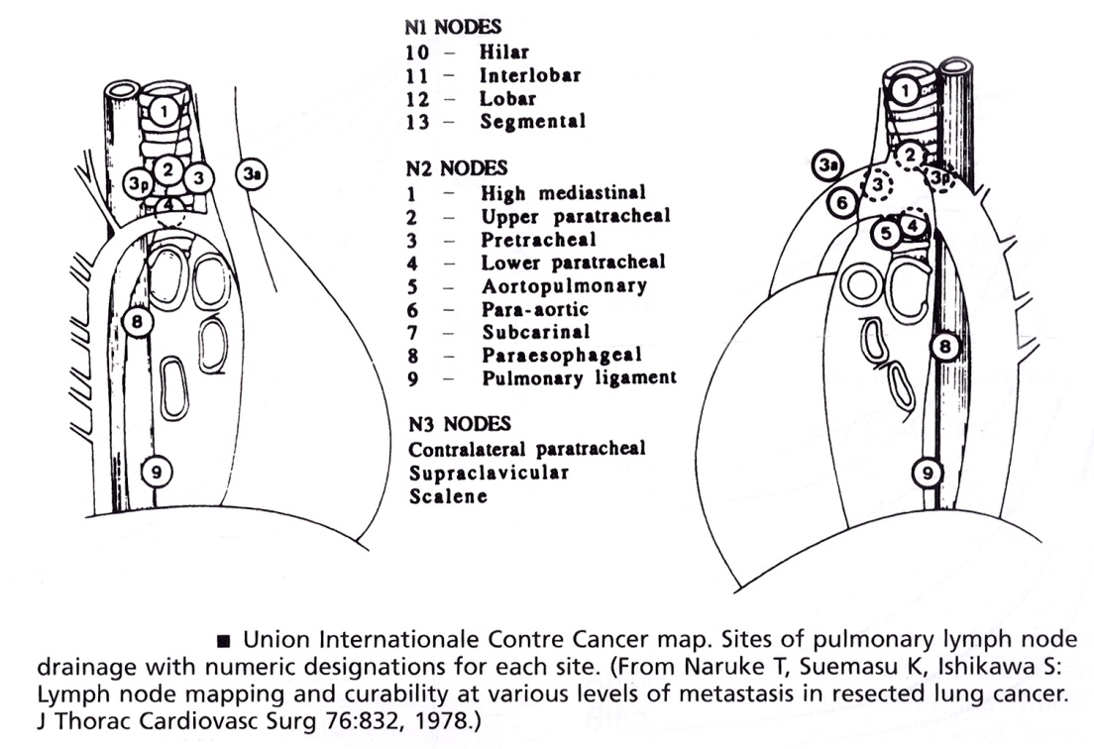
Lymph node mapping

Slide 13
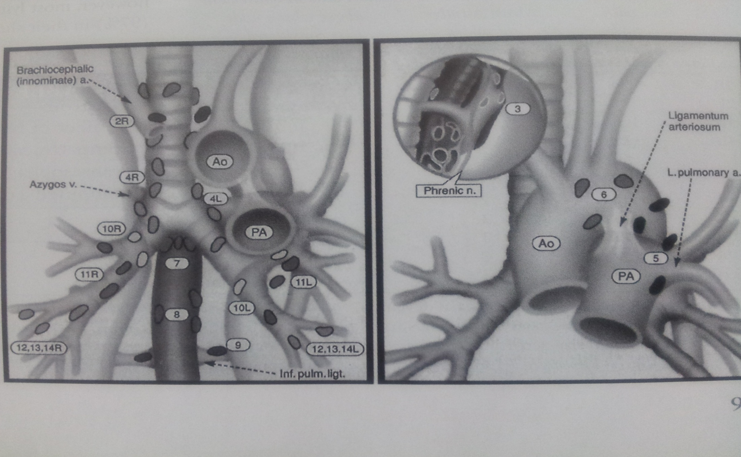
Superior mediastinal nodes
Aortic nodes
Inferior mediastinal nodes
Intrapleural nodes

Slide 14
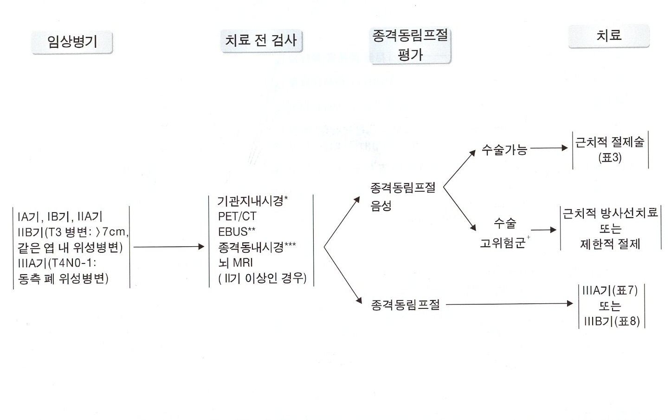

Slide 15
Diagnostic Tools
T stage: chest x-ray, chest CT,
bronchoscopy, PET-CT, (MRI)
N staging: chest CT, PET-CT
TBNA, EBUS-TBNA,
mediastinoscopy, mediastionotomy
M staging: physical exam, bone scan,
brain CT(MRI), PET-CT

Slide 16
Enlarged L.N. on chest CT
Positive CT result(> 1cm): 70% actual metastasis
→ histological confirm
False-negative rate less than 10% in negative CT result(< 1cm)
→T1/T2 + negative CT result: histologic confirm(?) (mediastinoscopy?)
cf. 28% false-negative rate on central T3
→ histological confirm(Daly et al. JTCS 94;664 1987)
cf. High rate of early metastasis in T1 adenoca, large cell ca

Slide 17
Mediastinoscopy/Mediastinotomy
Histologic diagnosis
Accurate determine the N2
Identify extranodal extension of tumor/ involvement of contiguous structure(trachea/ aorta)
Identify N3
Indication
L.N. enlargement more than 1cm on preop CT
Potential entry to neoadjuvant therapy protocol
Negative CT result in T2, T3 tumor and T1 adenoca/large cell ca(relative)

Slide 18
Mediastinoscopy/Mediastinotomy
Routine mediastinoscopy (with negative CT scan)
Low complication rate
Resectable N2 without neoadjuvant Tx(single station, ipsilateral, lower paratracheal, no extracapsular extension
High rate of thoracotomy(curative resection)
10-15% false negative rates on chest CT
Selective mediastinoscopy
High rate of negative mediastinoscopic examination(70%)
Possible complete resection of unsuspected N2
★ unsuspected N2: 8.9%(mostly inaccessable site; post subcarinal, periesophageal, anteroir mediastinal_)

Slide 19
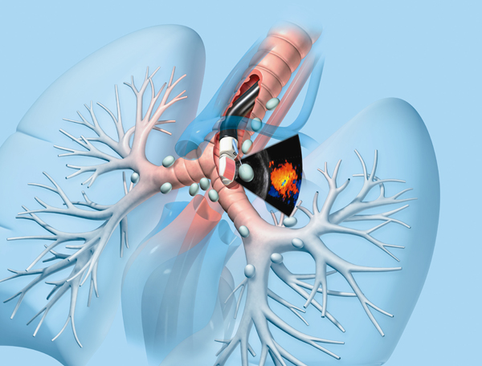
EBUS(+TBNA)
2007 ACCP:
invasive staging
mediastinoscopy대체 in stage II or central cancer
2009 NCCN:
IIIB 치료전 종격동검사 방법으로 권유
Node: 1R, 1L, 2R, 4R, 7,
10, 11(+)
5, 6, 8, 12(-)
Sensitivity 95%, specificity 100%

Slide 20
EBUS(+TBNA) 적용
폐암의 진단.
peripheral lung cancer
central parenchymal lung cancer, bronchoscopy(-)
폐암의 림프절 병기결정
PET N2(+) lung cancer: 민감도 93%, 정확도97%, 음성예측율91%
PET N2(-) lung cancer: 민감도 89%, 음성예측율 98.9%
→adenocarcinoma/ >5mm mediastinal node
Restaging the mediastinum after CCRT
민감도 76%,정확도 77%.음성예측율 20%로 치료전 시행된 것에 비해 낮은 민감도와 정확도 → 추가적 수술확인 필요
원인 불분명한 hilar, mediastinal Lymphadenopathy
Mediastinal mass

Slide 21
EBUS(+TBNA)
EBUS-TBNA 에서 림프절을 몇 회까지 흡인하는 것이 적절한가?
종격종 림프절의 최대한의 정확도를 얻기 위해서는 3회의 흡인이 필요하고 tissue core를 획득한 경우는 2회의 흡인이 필요하다.

Slide 22
PET-CT
양전자방출, 동위원소: F-18 fluordeoxyglocose(FDG)
폐암세포는 정상세포보다 포도당흡수가 증가, 당분해(glycolysis)속도가 높다.
PET-CT: CT 해부학적 구조(node size)
+ PET 기능적 구조(metabolism)
Granulomatous lesion(tuberculoma, histoplasmosis, rheumatoid nodule), inflammatory disease에서 양성
크기가 1-1.2cm보다 작을경우 확인 안될 수도 있다.
False (+) 20%, false (-) 20%
Carcinoid tumor, bronchioloalveolar carcinoma: PET(-)
PET detect unexpected distant meta in 10-15% NSCLC
& unexpected mediastinal node meta in 10%
종격동 PET-CT(-): 술전 mediastinoscopy시행하지 않아도 됨. 양성인 경우는 invasive test(mediastinoscopy or EBUS) 필요

Slide 24
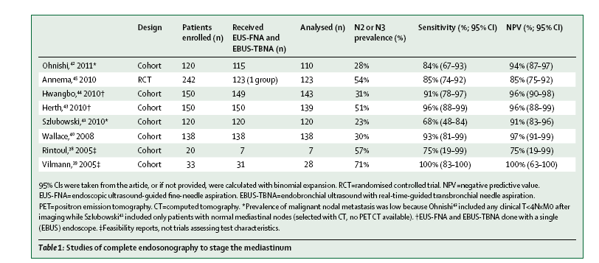

Slide 25
Physiologic staging
Age
Pre-existing lung condition(lung function)
Cardiovascular fitness
Nutrition and performance status(recent weight loss)
Smoking
Obesity
Patient attitude toward the disease

Slide 26
Age
Perioperative morbidity increase with advancing age →preop careful assessment of co-morbid
Clinically stage I, II over 70yrs: same with younger patients(beyond stage II, survival is very poor)
In Stage I, over 80 is not contraindication to lobectomy
Pneumonectomy is higher mortality risk(6-36%) in elder, Age should be a factor in deciding suitability for pneumonectomy

Slide 27
PFT
Poor resp function→perioperative morbidity/mortality
postop long term disability
poor quality of life
Additional test in poor, risk PFT test
Ventilation/perfusion scan(ppoFEV1,ppoDLCO)
VO₂max
SaO₂ after exercise
3 most important predictors of severe pul complications: D_{LCO}, FEV1/FVC, A-aDO₂

Slide 28
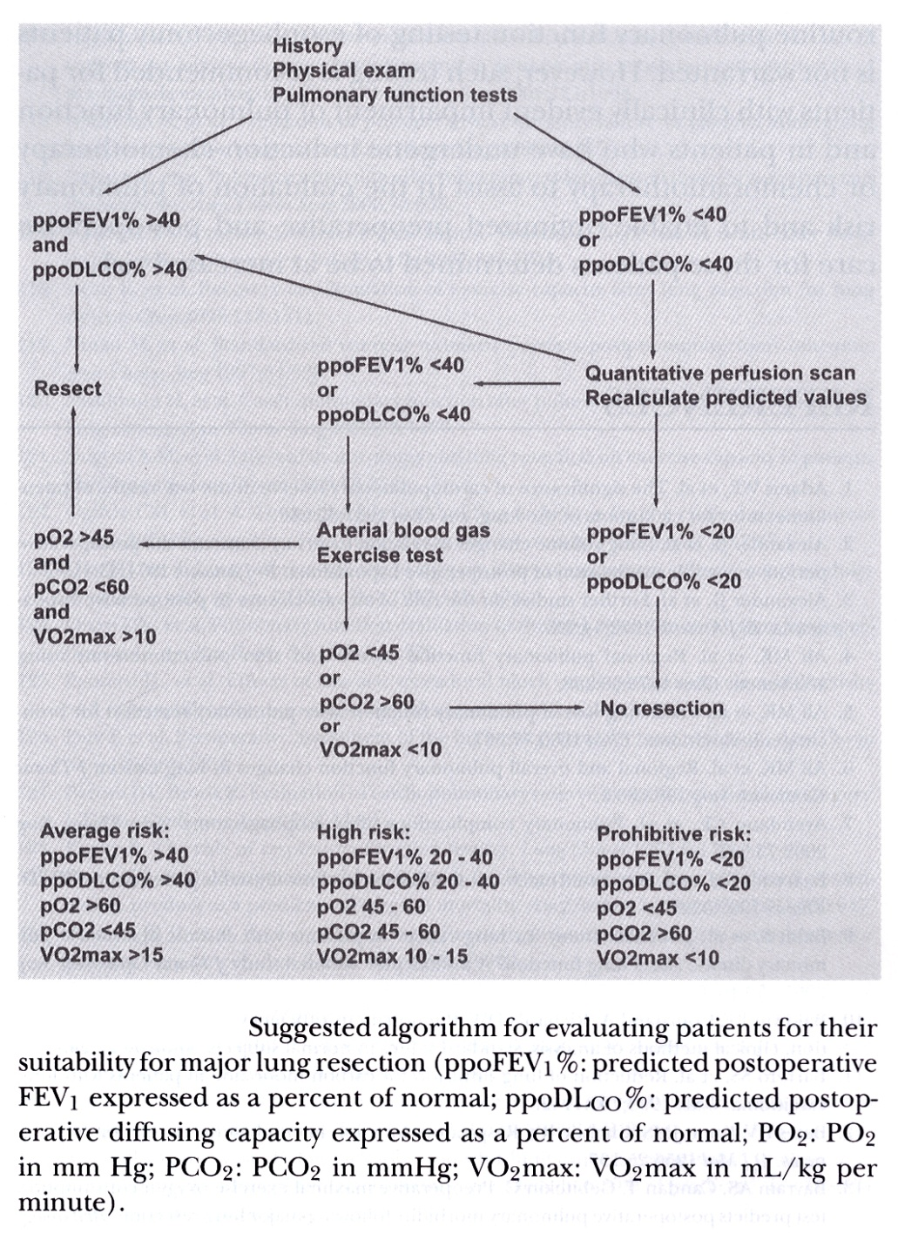
Low FEV1 postbrochodilator
Low DLCO postbronchodilator
Quantative perfusion scan
ppoFEV1, ppoDLCO
Exercise test
250m walking
Arterial blood gas/O2sat 감소
Peak oxygen consumption test
Absolute contraindication for resection
ppoFEV1 < 0.8 L
VO2max < 10ml/kg/min
↑CO2(cor pulmonale) in
pneumonectomy

Slide 29
Cardiovascular Fitness
All patients for lung resection should have preop ECG
All patients with audible cardiac murmur should have echocardiogram
After MI, operation for lung resection should not done within 6 weeks
MI within 6 month, ask cardiology opinion
CABG should not preclude lung resection
Pt with significant lesion on coronary angiography should be considered for CABG before lung resection
All patient with history of stroke, TIA, carotid bruits, should be assessed with carotid doppler

Slide 30
Cardiovascular Fitness

Slide 31
Cardiovascular Fitness

Slide 32
Weight loss, Performance status, Nutrition
Patient with preop wt loss >10% or more
And/or WHO 2 or worse→particular care staging assessment
Measure of nutritional status( body mass index, serum albumin level)

Slide 33
