Slide 1
Surgery for Congenital Anomalies and Benign Tumors of the Lung
고려대학교 구로병원
김 현 구

Slide 2
Congenital Abnormalities of the Lung

Slide 3
CASE 1
M/33
Symptoms
: Cough, sputum (onset: 2~3 weeks ago)
Lab.
: WBC: 7100, CRP: 9.99, Sputum culture: (-)

Slide 4
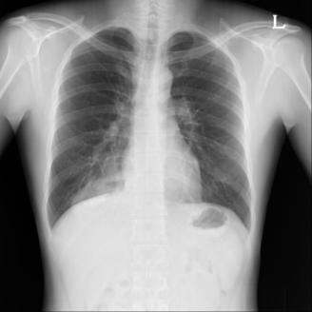
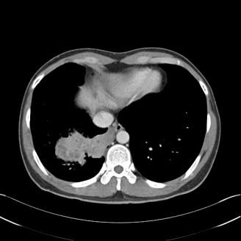
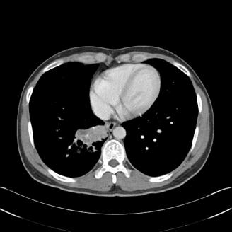
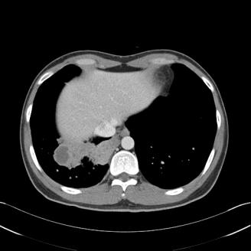
D/D Pneumonia with abscess formation in right basal lung, combined congenital anomaly

Slide 5
Operation

Slide 6
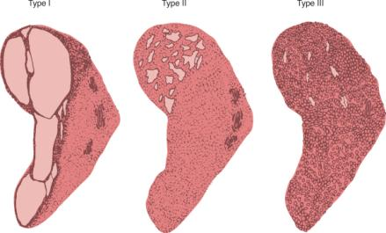
Congenital Cystic Adenomatoid Malformation (CCAM)
Segmental bronchial atresia during fetal lung bud development
Equally affected at both lungs, commonly in lower lobes
Size of lesion: primary determinant of prognosis
Stocker's classification of congenital cystic adenomatoid malformation. Type I typically has one or more large cysts. (55% of cases). Type II has numerous small cysts (<20mm). Type III is essentially a solid mass of tissue.

Slide 7
Symptoms
1. Cough and recurrent pulmonary infection in older children
2. Asymtomatic: incidentally noted in chest x-ray
Regression: first few months after birth
→ For asymptomatic patients, observation for 1 year is appropriate
Surgical resection
At the onset of respiratory symptoms
No evidence of regression
Reasons for early resection
1. Malignant potential: pleuropulmonary blastoma, rhabdomyosarcoma,
BAC (M/C in type I)
2. Expecting compensatory lung growth after resection

Slide 8
CASE 2
M/25
Symptoms
: Dyspnea (onset: 3~4 weeks ago)
Past Hx.
: 2년 전 건강검진에서 흉부 X-ray상 이상 소견 발견
Lab.
: WBC, ABGA: within normal limit

Slide 9
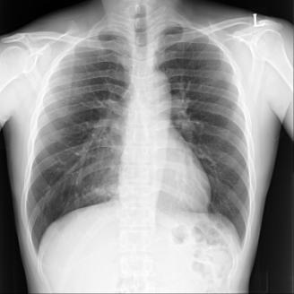
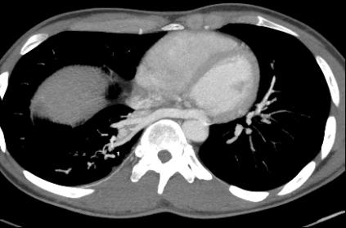
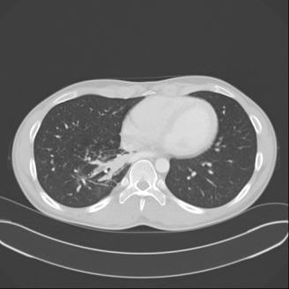
Abnormality in RLL with a large abnormal systemic artery supply from descending thoracic aorta.

Slide 10
Operation

Slide 11
Pulmonary Sequestration
Absence of communication with the tracheobronchial tree and pulmonary arteries
Blood supply: systemic artery
drainage: pulmonary or systemic veins
Symptoms
Hemodynamic changes, audible continuous murmur
Respiratory difficulties in an infant
Chronic pulmonary infection in older ages and teenagers
Asymptomatic mass in an adult

Slide 12
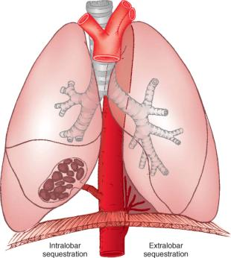
Extra / Intralobar type
Extralobar
Charateristics
Completely separate from the remaining lung
Has its own pleural investment
Usually located in the inferior portion of the thoracic cavity but,
anywhere from the neck to just below the diaphragm
Blood supply
Artery: descending aorta, abdominal aorta,
subclavian, intercostal
Vein: azygos, hemiazygos, subclavian, portal vein
May be connected with esophagus
3-D CT for finding systemic artery
Asssocaited congenital anomaly: Diaphragmatic hernia, pericardial defect, anomalous pulmonary venous drainage
Surgery
Resection soon after making diagnosis
Resection lesion itself without any accompanying lung tissue

Slide 13
Intralobar
Characteristics
Congenital, possibly acquired resulting from chronic infection
Surrounded normal lung tissue without separate pleural investment
Located in lower lobe in all cases
Blood supply
Artery: descending thoracic aorta, variable branches of aorta
Vein: inferior pulmonary vein, systemic vein
Recurrent infection
Surgery
Resection soon after diagnosis
Removal of the entire lobe including normal lung tissue

Slide 14
CASE 3
F/27
Symptoms
: right chest pain (onset: 5 days ago)
Lab.
: WBC, ABGA, Culture: within normal limit

Slide 15
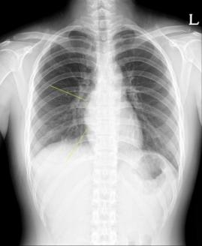
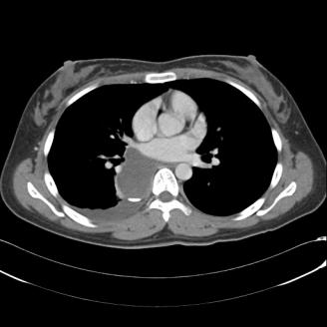
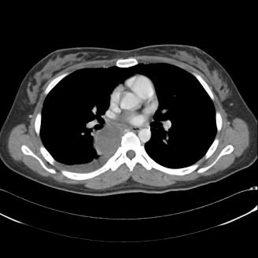

Slide 16
Operation

Slide 17
Bronchogenic Cyst
Type according to the location
Mediastinal
2/3 of patients
Paratracheal, carinal, hilar
Parenchymal
may communicate with bronchus
3. Others: Inferior pulmonary ligament, retroperitoneal, neck
Solitary cyst filled with fluid or mucus
Symptoms
Compression of air way
: wheezing, stridor, shortness of breath, pneumonia, emphysema
1/3 of patients
: incidental on imaging in asymptomatic child or adult

Slide 18
Surgery
Soon after diagnosis because of high
likelihood of symptoms developing
Simple resection for mediastinal location
Extensive resection for parenchymal location

Slide 19
Congenital Abnormalities of Lung
TABLE 40-1 -- Congenital Abnormalities of the Lung
Lesion | Location | Radiologic Findings | M:F | Symptoms | Vasculature
Lobar emphysema | LUL 40% | Hyperlucent lobe | 2.5 : 1 | Tachypnea, respiratory distress | Normal
 | RML 35% | Mediastinal shift
 | RUL 20% |  |  | Wheezing
CCAM | Equal all lobes | Type I—single cyst | 1 : 1 | Respiratory distress | Normal
 |  | Type II—many small cysts
 |  | Type III—solid mass
Sequestration
Extralobar | Basilar, left 80% | Wedge-shaped mass | 2 : 1 | Usually none | Arterial—descending aorta
 |  |  |  |  | Venous—hemiazygos
Intralobar | Posterior basal, left 60% | Cyst or solid | 1 : 1 | None or infection | Arterial—descending aorta
 |  |  |  |  | Venous—Pulmonary vein
Bronchogenic cyst
Mediastinal | Pericarinal | Round mass | 1 : 1 | None or wheezing | Normal
Parenchymal | Lower lobes | May contain air | 1 : 1 | Infection, wheezing | Normal

Slide 20
Inflammatory Diseases of the Lung

Slide 21
CASE 4
M/59
Symptoms
Recurrent hemoptysis (onset: 4 years ago)
Hemoptysis
Onset: 4~5 days ago
Amount: 소주 반잔
Frequency: 1회/1일

Slide 22
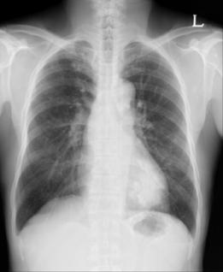
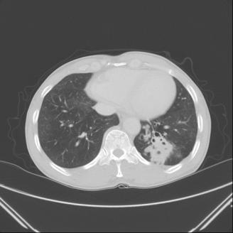
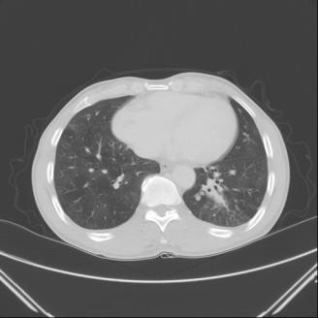
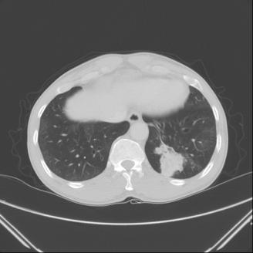
Necrotizing pneumonia in LLL, and bronchial dilation with bronchial wall thickening and ground-glass opacities

Slide 23
Operation

Slide 24
Bronchiectasis
Definition
Permanent and abnormal dilatation of bronchi caused by destruction of the elastic and muscular components of the bronchial wall
Causes
1. Congenital
Diffuse
Cystic fibrosis, Ciliary dysmotility syndrome, Kartagener’s syndrome
2. Acquired
Localized
Infection: adenovirus, influenza virus, S aureus, K pneumonia, H influenza,
aspergilloma, tuberculosis
Noninfectious diseases
1) Extrinsic compression: mediastinal lymphadenopathy
2) Endobronchial stenosis by tumor or foreign body
3) Inhalation of toxic gas or aspiration of gastric contents

Slide 25
Pathologic classification
Cylindrical: uniformly dilated bronchi
Saccular: dilated peripheral bronchi
Mixed or varicose: irregular or beaded dilatation of bronchi
Symptoms
Chronic or recurrent pulmonary infection with abundant
sputum production
Hemoptysis
More likely affected at lower lobe
More at left side

Slide 26
Conservative therapy
Goal: Treatment of a reversible underlying disease
Adequate antibiotics: 2~3 weeks iv + oral
Bronchodilator
Physiotherapy
Mucolytics
Surgery
Role of Surgery for Bronchiectasis
Curative: in strictly localized forms
Palliative
Removal of most diseased areas
Decrease of mucus production
Decrease of systemic shunt
Ultimative: transplantation for end-stage disease
Criteria for Surgical Intervention
Localized disease
Adequate pulmonary reserve
Irreversible process
Significant symptoms (e.g., cough, hemoptysis, recurrent pneumonia, shunt)

Slide 27
CASE 5
M/58
Symptoms
: Hemoptysis (recent onset: 1 day ago, amount: 100cc)
Past Hx.
2003년부터 hemoptysis로 3차례 입원
Bronchial and intercostal arteries embolization: 3 times
Lab.
: WBC: 17100, Hgb: 10.7 CRP: 33.6

Slide 28
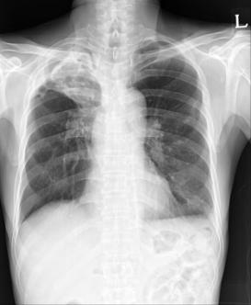
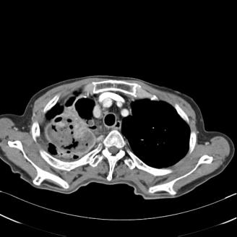
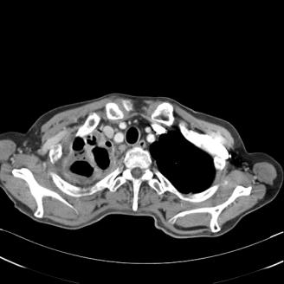
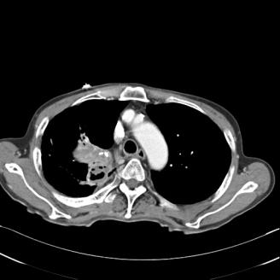
. Large cavitary lesion
; DDx reactivated TB, chronic necrotizing aspergillosis
. Obstruction of RUL bronchus

Slide 29
Operation

Slide 30
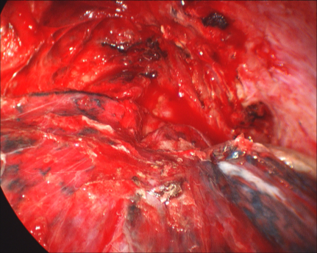
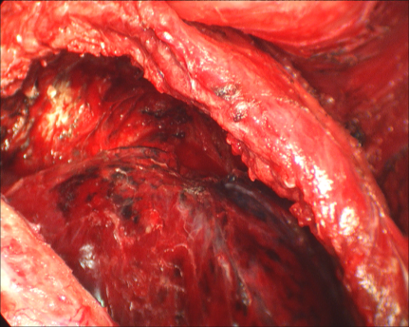
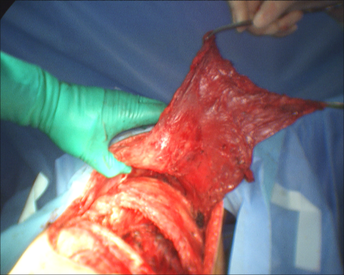
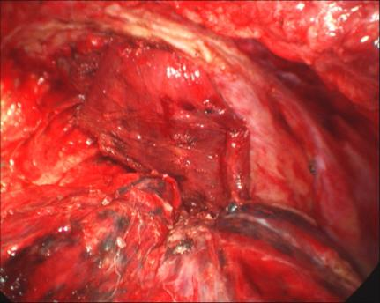

Slide 31
Aspergillosis
Aspergillus: Ubiquitous fungal genus
M/C antecedent: tuberculosis
Clinical manifestrations
Localized form
Saprophytic disease, aspergilloma, mycetoma
Opportunistic infection in individuals with underlying lung disease
Colonizing of preexisting parenchymal cavity
Formation of tangled mass of hyphae, blood element, debris in the cavity
2. Allergic bronchopulmonary aspergillosis
Complex immunologic reaction of the host to noninvasive aspergillus species
Productive cough, fever, episodic wheezing, variable pulmonary infltrates,
eosinophillia, elevated IgE antibody to Aspergillus
3. Disseminated form in immunosuppressed patients

Slide 32
Diagnosis
CXR
Monod’s sign: round dense opacity occupying some or most of the cavity and surrounded partially by a crescent of air in upper lung
CT: evaluating underlying pulmonary disease
Sputum: birefringent calcium oxylate crystal in polarizing light microscopy
Bronchoscopy: finding bleeding focus
Serologic test, skin test in patient with culture-negative

Slide 33
Treatment
Asymtomtic aspergilloma
: Not require treatment unless the patient with mass of unknown cause of
malignancy
Mild non-life threatening hemoptysis
Conservative medical treatment
: Oxygenation, humidification, cough suppressant, postural drainage, oral or
intravenous antibiotics
More severe hemoptysis
Bronchial artery embolization: recur in more than 50%
Systemic antifungal agent: not effective
Endobronchial or intracavitary instillation of various antifungal agents
Indications for surgical resection
1. Recurrent gross hemoptysis 2. Life-threatening hemoptysis 3. Chronic cough with systemic symptoms 4. Progressive infiltrate surrounding the mycetoma 5. The inability to rule out malignancy in an indeterminate mass
6. Lung biopsy for diagnosis of invasive aspergillosis

Slide 34
CASE 6
M/11
Symptom
: Dyspnea, cough, sputum (onset: 5 days ago)
Lab.
: ABGA: 7.392 – 47.3mmHg, - 65.3mmHg – 85.1%

Slide 35
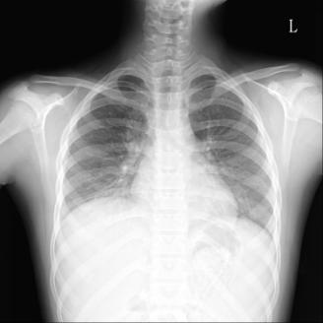
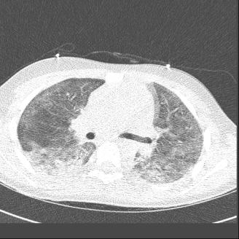
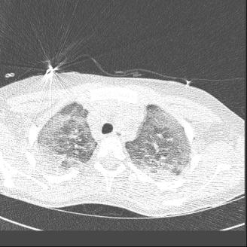
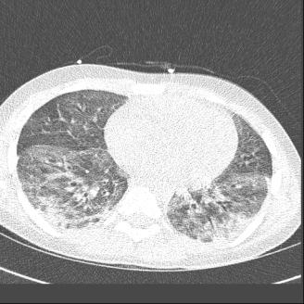
Diffuse ground-glass opacities in both lungs, mildly aggravated; D/D Diffuse pneumonia, DAD pattern.

Slide 36
Operation

Slide 37
Interstitial Lung Disease
Clinical Entity | Pathologic Description | Occupational Causes
Idiopathic pulmonary fibrosis (IPF) | Usual interstitial pneumonia | Asbestosis, uranium mining, plutonium, mixed dusts
Nonspecific interstitial pneumonia (NSIP) | Nonspecific interstitial pneumonia | Organic antigens
Desquamative interstitial pneumonia (DIP) | Desquamative interstitial pneumonia | Textile work, aluminum welding, inorganic particles
Bronchiolitis obliterans and organizing pneumonia (BOOP) | Bronchiolitis obliterans and organizing pneumonia | Spray painting of textiles—acramin-FWN; NOx
Pulmonary alveolar proteinosis | Alveolar proteinosis | High-level silica exposure, aluminum dust
Giant cell interstitial pneumonia (GIP) | Giant cell interstitial pneumonia | Cobalt (in hard metal)
ARDS/AIP | Diffuse alveolar damage | Irritant inhalational injury—NOx, SOx, cadmium, beryllium, chlorine, acid mists
Bronchiolitis obliterans (BO) | Constrictive bronchiolitis | NOx, chlorine gas
Bronchiolitis | Cellular bronchiolitis | Organic antigens
Sarcoidosis | Granulomatous inflammation | Beryllium, organic antigens, zirconium, aluminum, titanium
Lipoid pneumonia | Lipoid pneumonia | Oil-based fluid exposure

Slide 38
Indications of TBLB or Surgical lung biopsy
A. In a symptomatic and/or functionally impaired patient with unexplained physiologic and radiologic features that do not have a characteristic recognizable pattern of ILD (e.g., usual interstitial pneumonia [UIP] or sarcoidosis)
B. If the clinical features (in the following list) are suggestive of specific diagnoses other than IPF, the diagnosis of IPF requires histologic exclusion of other specific entities by surgical lung biopsy/TBLB:
1. Relatively younger patient (<65 years of age) 2. History of fever, weight loss, sweats, hemoptysis 3. Family history of apparent ILD 4. Symptoms and signs related to peripheral vasculitis 5. History of pneumothorax (especially recurrent) 6. Atypical radiographic features of IPF: 7. Normal chest radiograph 8. Unexplained extrapulmonary manifestations 9. Unexplained pulmonary hypertension 10. Unexplained, associated cardiomegaly at the time of presentation 11. Rapidly progressive disease (functional, objective) 12. Rapid deterioration or new symptoms with new radiologic abnormalities in
focal areas in a patient with long-standing stable ILD.

Slide 39
Open lung biopsy via thoracotomy
: Accurate diagnosis in more than 90% of patients
VATS
Excellent visualization of the whole lung and pleural surfaces
Less operative time
Reduced in the use of analgesia and the postoperative hospital stay
Morbidity: 20% to 50% vs. 0% to 25%
Mortality: 0% to 21% vs. 0% to 10%
The appropriate site of lung biopsy
The coordinated efforts and interaction of the pulmonologist, surgeon, and pathologist are essential for deciding the site of lung biopsy for optimal diagnostic yield guided by HRCT findings.
Regions of honeycombing cysts seen in HRCT reveal mere end-stage pulmonary fibrosis of no diagnostic value.
Biopsy samples must be obtained from several sites; apparently normal lung parenchyma adjacent to and remote from obviously abnormal sites, as well as visibly abnormal areas, must be sampled.
A preoperative chest HRCT guides selection of appropriate areas to biopsy. If the process appears to be relatively uniform and diffuse, two or three specimens from different sites/lobes (right or left lung based on CT images) are sufficient.
The tip of the lingular segment or middle lobe are generally avoided in diffuse ILD because inflammatory changes and scarring unrelated to the diffuse disease, as well as passive congestion, are likely to be affected in these sites.

