Slide 1

PADO:
Endovascular, Surgical and Hybrid Treatment
It’s much more than just technology
►
Department of Thoracic and Cardiovascular Surgery
KangBuk Samsung Medical Center,
Sungkyunkwan University, School of Medicine
Joon Hyuk Kong

Slide 2
I. Overview
►

Slide 3
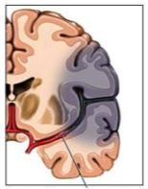
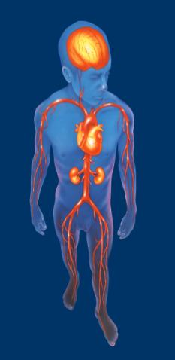
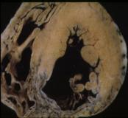
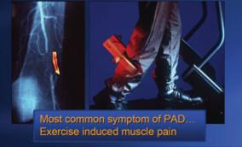
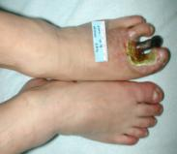
Major manifestations of atherothrombosis
►
  Cerebrovascular disease
  Coronary artery disease
  Renal artery stenosis
  Visceral arterial disease
  Peripheral arterial disease
    Intermittent claudication
    Critical limb ischemia
Notes:
Major manifestations of atherothrombosis
Vascular disease leading to atherothrombosis, is the result of a generalized process that affects multiple vascular beds, including the cerebral, coronary, and peripheral arteries. Coexistence of vascular disease in multiple beds increases the risk for developing ischemic events such as MI and stroke.¹
Atherothrombosis in cerebral arteries may precipitate a transient ischemic attack (TIA) or an ischemic stroke. A TIA, by definition, lasts for fewer than 24 hours, but the majority resolve within 1 hour. A TIA may be a warning of an impending stroke, with the risk for a stroke being 8–12% during the first week following a TIA and 11–15% at one month.²
Atherothrombosis in coronary arteries produces a spectrum of ischemic coronary syndromes that include stable angina, unstable angina, non–ST-segment elevation myocardial infarction (NSTEMI; also known as non–Q-wave MI), and ST-segment elevation (STEMI; also known as Q-wave MI). Cardiovascular disease is the single largest cause of death in the United States and Europe.³
Atherothrombosis in peripheral vessels, known as peripheral arterial disease (PAD), can produce a variety of symptoms ranging from intermittent claudication to pain at rest.⁴
Patients with the most serious PAD have critical limb ischemia that produces pain at rest and threatens the viability of the limb by increasing the risk for gangrene and necrosis.⁴ PAD is a strong marker for cardiovascular disease. Over a 10-year period, PAD increases risk for death due to cardiovascular disease approximately 6-fold.⁵
Note: Clopidogrel is not indicated for all the conditions listed on this slide.
References:
Aronow WS, Ahn C. Prevalence of coexistence of coronary artery disease, peripheral arterial disease, and atherothrombotic brain infarction in men and women ≥62 years of age. Am J Cardiol 1994; 74: 64–65.
Coull AJ, Lovett JK, Rothwell PM . Population based study of early risk of stroke after transient ischaemic attack or minor stroke: implications for public education and organisation of services. BMJ 2004; 328 (7435): 32.
American Heart Association. 2002 Heart and Stroke Statistical Update.
Weitz JI, Byrne J, Clagett GP et al. Diagnosis and treatment of chronic arterial insufficiency of the lower extremities: a critical review. Circulation 1996; 94: 3026–3049.
Criqui MH, Langer RD, Fronek A et al. Mortality over a period of 10 years in patients with peripheral arterial disease. N Engl J Med 1992; 326: 381–386.

Slide 4
Systemic Atherosclerosis
►
JAMA 2006;295:180-189.

Slide 5
Prevalence of PAD increases with age
►
Rotterdam Study (ABI Test <0.9)¹ San Diego Study (PAD by noninvasive tests)²
Patients with PAD (%)
Figure adapted from Creager M, ed. Management of Peripheral Arterial Disease. Medical, Surgical and Interventional Aspects. 2000.
1 Meijer WT et al. Arterioscler Thromb Vasc Biol 1998; 18: 185-192.
2.Criqui MH et al. Circulation 1985; 71: 510-515.
Notes:
Prevalence of PAD increases with age
The prevalence of peripheral arterial disease (PAD) is age dependent. In the Rotterdam study (n=5,450), the prevalence of PAD based on the ankle-brachial index (ABI) increased from 9% of subjects 55 to 59 years of age to 57% of patients 85 to 89 years of age.¹
Similarly, the prevalence of PAD increased from 2.5% in subjects 40 to 59 years of age to 18.8% in subjects 70 to 79 years of age in the San Diego population study (n=624). Prevalence was diagnosed using noninvasive tests of limb perfusion: segmental blood pressure, flow velocity, postocclusive reactive hyperemia and pulse reappearance half time.²
Discussion Points
Based on the statistics from the Rotterdam study, in a practice of 2,000 patients with about 300 patients over 85 it could be estimated that approximately 170 patients would be diagnosed with PAD.
Q. How does this correlate to the experience in your own practice; how many patients would you estimate have been diagnosed with PAD in your patient population and how many might there be of whom you are not aware?
References:
Meijer WT, Hoes AW, Rutgers D et al. Peripheral arterial disease in the elderly: the Rotterdam Study. Arterioscler Thromb Vasc Biol 1998; 18: 185–192.
Criqui MH, Fronek A, Barrett-Connor E et al. The prevalence of peripheral arterial disease in a defined population. Circulation 1985; 71: 510–515.

Slide 6
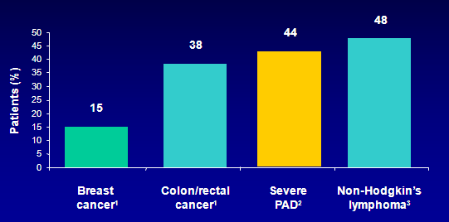
►
Mortality is very high in patients
with severe PAD
Relative 5-year mortality
1. Criqui MH. Vasc Med 2001; 6 (suppl 1): 3–7.
2. McKenna M et al. Atherosclerosis 1991; 87: 119–28.
3. Ries LAG et al. (eds). SEER Cancer Statistics Review, 1973–1997. US: National Cancer Institute; 2000.
Notes:
Mortality is very high in patients with severe PAD
Risk of death associated with peripheral arterial disease (PAD) is as high as for many common cancers.¹ In a US study of 744 patients tested for PAD, those with severe PAD (ABI < 0.4) had a 5-year survival probability of only 56%.² This is comparable to the 52% survival in white patients with non-Hodgkin’s lymphoma, as recorded from 1986–1993 by Ries et al.³ Data for colon and breast cancer are reported in the same source.
References:
1. Criqui MH. Peripheral arterial disease - epidemiological aspects. Vasc Med 2001; 6 (suppl 1): 3–7.
2. McKenna M et al. The ratio of ankle and arm arterial-pressure as an independent predictor of mortality. Atherosclerosis 1991; 87: 119–128.
3. Ries LAG et al. (Eds). SEER Cancer Statistics Review, 1973–1997. US: National Cancer Institute; 2000.

Slide 7
Risk of death is increased in patients with both symptomatic and asymptomatic PAD
►
100
Normal subjects
75
Asymptomatic PAD†
50
Survival (% of patients)
Symptomatic PAD†
25
Severe symptomatic PAD†
0
0
2
4
6
8
10
12
Year
*Kaplan-Meier survival curves based on mortality from all causes.
†Large-vessel PAD.
Criqui MH et al. N Engl J Med 1992; 326: 381-386.
Notes:
Risk of death is increased in patients with both symptomatic and asymptomatic
PAD
Criqui et al conducted a study to evaluate the mortality rate from all cardiovascular diseases and coronary heart disease in patients with large-vessel peripheral arterial disease.¹ In the initial screening of 565 patients, 67 patients (11.9%) with PAD were identified by noninvasive testing (measurement of segmental blood pressure and determination of flow velocity by Doppler ultrasound). These patients were then followed prospectively for 10 years.
Results revealed a 15-fold increase in rates of mortality due to cardiovascular disease and coronary heart disease among patients with PAD that was both severe and symptomatic. The survival curves for patients with PAD demonstrate a poor prognosis for these patients. Although there appears to be a direct relationship between severity of disease and reduction in survival, even asymptomatic patients have lower survival rates compared with healthy subjects. After 10 years, about half of asymptomatic patients survive, whereas only 25% of severely symptomatic patients survive.
Reference:
Criqui MH, Langer RD, Fronek A et al. Mortality over a period of 10 years in patients with peripheral arterial disease. N Engl J Med 1992; 326: 381-386.

Slide 8
►
Fate of patients with CLI
Norgren L, et al. TASCII, J Vasc Surg.2007

Slide 9
PVD is not Benign!!!
►
The diffuse nature and high association of PVD with other medical conditions (ie, diabetes, renal disease, coronary disease, wound care) demand a multidisciplinary approach toward patient care at a PVD center of excellence.
Every patient with PVD needs a multidisciplinary work-up and needs treatment.
This treatment may be as simple as risk factor modification and follow- up, medications, or complex treatments requiring interventional or surgical treatment.
Establishing aPeripheral VascularCenter of Excellence. DAVID E. ALLIE, MD; CHRIS J. HEBERT, RT, R-CIS; AND CRAIG M. WALKER, MD. FEBRUARY 2005 I ENDOVASCULAR TODAY I 41

Slide 10
Multidisciplinary Team
►
A true PVD center of exellence cannot exist without close cooperation and input from a true multidisciplinary “team” approach,
  surgeon,
  cardiologist,
  peripheral interventionalists,
  podiatrists, and
  specialists in vascular medicine, diabetes, nephrology, neurology, wound care, and vascular imaging,
  along with well-trained registered nurses, nurse practitioners, and physician assistants.
Establishing aPeripheral VascularCenter of Excellence. DAVID E. ALLIE, MD; CHRIS J. HEBERT, RT, R-CIS; AND CRAIG M. WALKER, MD. FEBRUARY 2005 I ENDOVASCULAR TODAY I 41

Slide 11
Clinical Success Assessment
►
Primary patency: persistent patency without any repeat intervention (TLR-free survival)
Primary assisted patency: patency after repeat endovascular intervention for morphologic, clinically relevant restenosis plus all cases of primary patency. (post-TLR free survival for restenosis & TLR-free survival)
Secondary patency: patency after repeat endovascular intervention for occluded graft (thrombosis) plus all cases of primary and primary assisted patency (All post TLR free survival)
Hemodynamic; ABI > 0.1 or 0.15 after intervention
Symptom: Rutherford or Fontaine category > 1

Slide 12
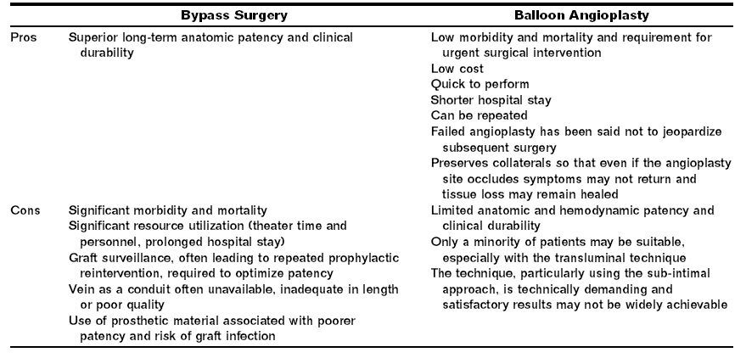
Bypass vs Angioplasty
►
BASIL trial (Bypass versus Angioplasty for Severe Ischaemia of the Leg)

Slide 13
II. Schema
►
Arterial occlusive disease
  Clinical:
    Acute arterial occlusion
      Acute embolism
      Acute thrombosis
    Chronic arterial occlusion
  Cause:
    Aatherosclerosis
    Vasculitis, Arteritis
    Takayasu’s arteritis
    Buerger’s disease
Arterial aneurysm
- Anatomical: Aortic, other arterial
- Cause:
Nonspecific (degenerative),
Connective tissue disease
Mycotic,
Others
- Patologic : True vs. False aneurysm

Slide 14
II. Schema
►
Acute limb ischemia
Chronic limb ishemia

Slide 15
II-1. Acute Limb Ischemia
►

Slide 16
Definition
►
Sudden occlusion of an artery is commonly due to either emboli or trauma & it may also happen when thrombosis occur on plaque pre-existing atheroma.

Slide 17
Cause
►
Acute arterial embolism
Acute arterial thrombosis
Graft occlusion)
Thrombotic occlusion of peripheral arterial aneurysm

Slide 18
Cause - Emboli
►
●Arterial source (9%)
Atherosclerotic aorta
Aneurysm
●Other (1%)
Pardoxial.
Hx of medication (oral contraceptives)
●Cardiac (90%)
Arrhythmia (atrial fibrillation)
Valvular heart diseaes. ( MS)
Prosthetic heart valves.
Hx of myocardial infarction.
Atrial myxoma.

Slide 19
Cause - Emboli
►
Origin of Acute Arterial Embolism:
Cardiac 80%
Af 50%
MI 25%
Valve and Others 5%
Non-Cardiac 10%
Aneurysm 6%
Prox. Artery 3%
Paradoxical 1%
Unknown 10%

Slide 20
Cause - Emboli
►
Emboli usually impact at branching points in arterial tree, particularly at the bifurcation of the aorta, the common femoral bifurcation & popliteal trifurcation.

Slide 21
Cause - Emboli
►
Sites of occlusion embloi to the lower limb:
Abdominal bifurcation 10-15%
Iliac artery branch 15%
Femoral artery branch 40%
Popliteal artery 10%
Upper extremity 10%
Cerebral artery 10-15%
Mesenteric & Intraabdominal 5%

Slide 22
Cause - Thromosis
►
Thrombosis usually occur on a pre-existing atherosclerotic lesion.
Occasionally thrombosis occur on relatively normal artery in patients with hypercoagulabale states
  ex: Pt with malignancy, polycythemia or pt taking high doses of oestrogen.

Slide 23
Cause - Trauma
►
It is important to determine a history of arterial trauma, arterial catheterization, intra-arterial drug induced injection, aortic dissection, limb fractures.

Slide 24
Clinical Features

Slide 25
Clinical Features
►
The 5 (6) P’s :
  Pain.
  Pallor.
  Pulselessness.
  Paraesthesia.
  Paralysis.
  Perishing cold.

Slide 26
Clinical Differentiation Between Embolism & Thrombosis
►
Embolism:
obvious cardiac source
No hx of cluadication
Normal pulses in contralateral limb
Angiogram: minimal atherosclerotic
Few collateral
Thrombosis:
No obvious cardiac source.
history of cluadication.
abnormal pulses in contralateral limb.
Angiogram: diffuse atherosclerotic
Well developed collateral

Slide 27
Management
►

Slide 28
Immediately
►
Anticoagulant with heparin to prevent propagation of thrombus & distal thrombosis & this achieved by giving a bolus of 10,000 units of heparin intravenously & an infusion of about 1000 units of heparin per hour after that.
In pt thrombosis is thought to be the dx arteriography should be considered to define the extant of problem before revascularization.

Slide 29
???????
►
Is it possible to remove thrombus or emboli with Fograty Catheter?
Is it possible to treat underlying cause ( origin of emboli or origin of thrombus)
If not, what should we do?

Slide 30
Embolectomy
►
This operation usually performed under local anaesthesia.
A groin incision is made & the common femoral artery is opened.
often the clot is found in the artery a Fogarty balloon catheter is passed in turn into the proximal & distal arteries the balloon is inflated & the catheter withdrawn removing the clot.

Slide 31
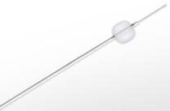
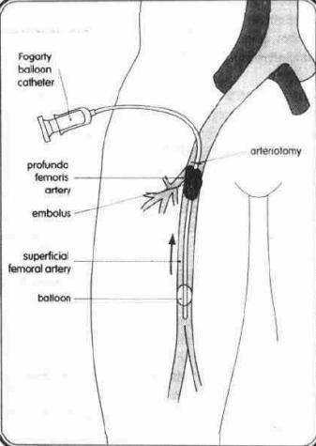
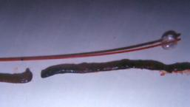
Embolectomy
►
Fogarty’s balloon catheter

Slide 32
Thrombolytic Therapy
►
Percutaneous intra-arterial thrombolytic therapy.
Takes approximately 12-72 hours to dissolve the clot.
Agents used: streptokinase, urokinase & tissue plasminogen activator.
Mechanism: The convert plasminogen to plasmin which the active lytic agent.

Slide 33
Case Presentation
►
Embolectomy: antegrade approach at Rt CFA

Slide 34
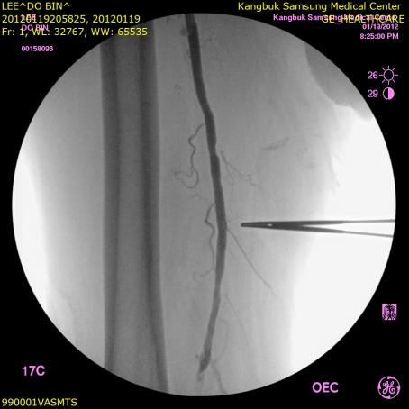
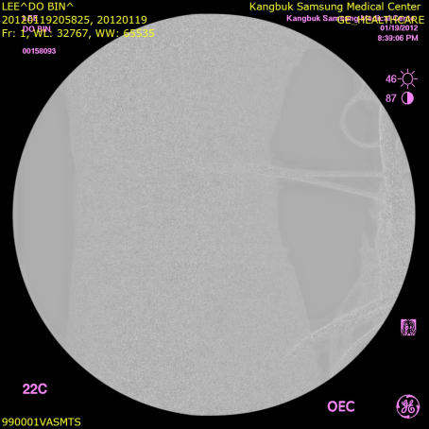
Diagnostic Angio
►

Slide 35
Case Presentation
►
Thombectomy: retrograde approach at Rt PTA

Slide 36
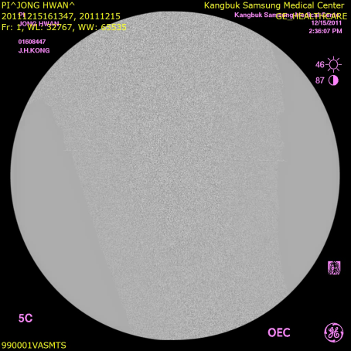
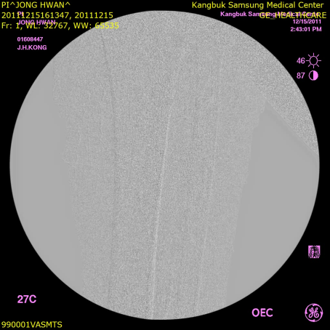
Rt vs Lt : upper BTK
►

Slide 37
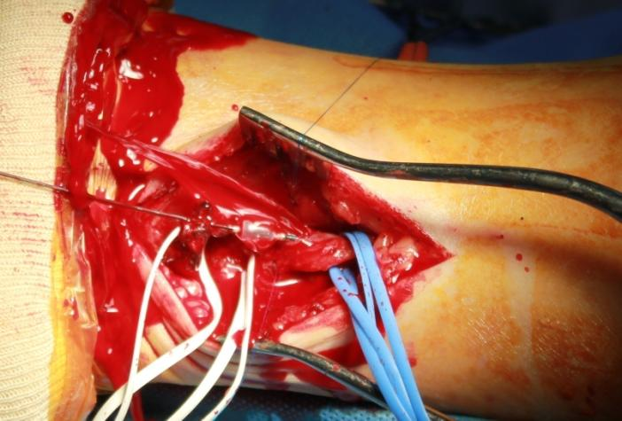
Rt PTA 018+Fogary (mag)
►

Slide 38
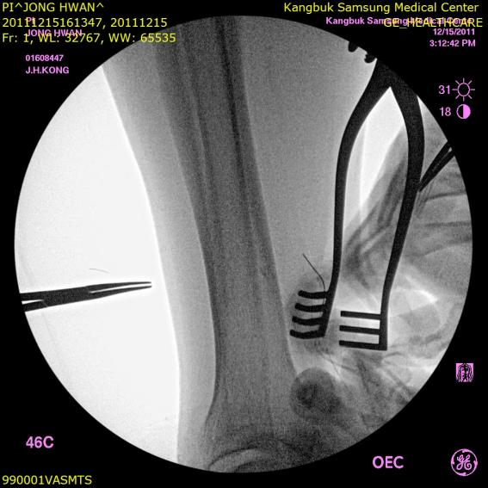
Rt PTA Embolectomy
►

Slide 39
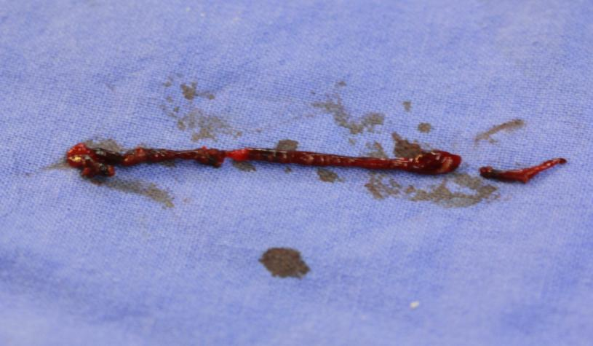
Rt PTA Embolus

Slide 40
Case – Other Hospital
►
CIA CTO due to combination of Thrombosis and Stenosis

Slide 41
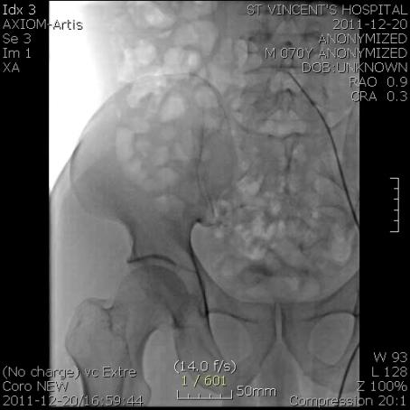
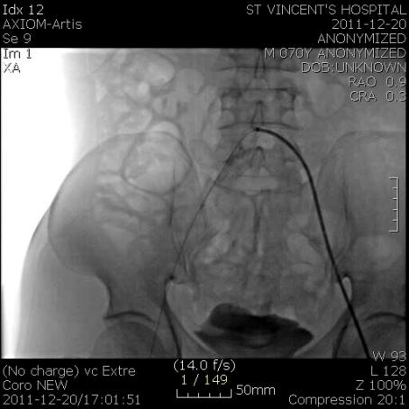
Initial and PTA
►

Slide 42
Complications
►

Slide 43
Ischemia-Reperfusion Injury
►
Ischemic injury
Reperfusion injury

Slide 44
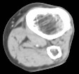
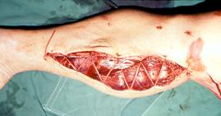
Compartment Syndrome
►
Acute arterial occlusion → LE Muscle ischemia & reperfusion
→ Muscle swelling → Compartment syndrome → Fasciotomy

Slide 45
Metabolic Complicastions
►
Metabolic acidosis
Hyperkalemia
Acute renal failure, myoglobinuria

Slide 46
II-2. Chronic Limb Ischemia
►

Slide 47
Definition
►
It is the decrease in arterial blood supply to the tissues due to partial occlusion of arteries.
Stenosis or occlusion produces symptoms & signs that are related to the organ supplies by the artery.
The severity of symptoms is related to the size of the vessel occluded & alternative routes (collaterals) available for blood flow.

Slide 48
Causes
►
Atherosclerosis (ASO)
Burger’s disease
Raynaud’s disease
Others

Slide 49
Definition of ASO
►
It is the process underlying the formation of focal obstructions or plaques in large & medium sized arteries.
It is characterised by the presence of focal intimal thickening, these intimal elevations being made up of accumulations of cholesterol rich & a proliferation of connective tissue.
An essential component of atherogenesis is inflammation involving monocytes / macrophages, T lymphocytes & mast cells.

Slide 50
Risk Factors of ASO
►
  Smoking
  Hypertension
  Hyperlipidaemia (raised LDL) High risk factors
  High fat diets
  Diabetes mellitus
  Elevated blood uric acid (gout)
  Hypothyroidism
  Renal disease Other risk factors
  Familial history of premature atherosclerosis
  Male sex & age
  Sedentary life
  Obesity Factors having an uncertain role
  Anxiety

Slide 51
Common sites of plaque formation in arteries
►
  Branch points.
  Tethered sites like in superficial femoral artery in Hunter’s canal in the leg.

Slide 52
Definition of Burger’s Disease
►
It is occlusive disease of small & medium size arteries, thrombophlebitis of superficial or deep veins & Raynaud’s syndrome.
It occurrs in male patients with heavy smoking & usually under the age of 30 years.

Slide 53
Characteristics of Burger’s disease
►
Histology:
Localised inflammatory changes occur in walls of arteries and veins leading to thrombosis.
Clinical picture:
The usual symptoms and signs of arterial occlusive disease are present.
Gangrene of the toes and fingers is common and progressive.

Slide 54
Clinical Manifestation
►
Non-Critical Limb Ischemia
Cricial Limb Ischemia (CLI)

Slide 55
Site of Lesions
►
Aortoilliac | Claudication of both buttoks, thighs and calves, femoral and disal pulses absent,bruits, impotence
Illiac | Unilateral claudication of thigh, calf Unilateral absence of femoral and distal pulses
Femoropopliteal | Unilateral claudication in calf , femoral pulse palpable with absent unilateral distal pulses
Distal obstruction | Femoral & popliteal pulses palpable, ankle pulses absent, cluadication in calf & foot

Slide 56
Differentiating True Claudication from Pseudoclaudication
►
 | Intermittent Claudication | Pseudoclaudication
Character of discomfort | Cramping, tightness, tiredness | Same or tingling, weakness, clumsiness
Location of discomfort | Buttock, hip, thigh, calf, foot | Same
Exercise induced | Yes | Yes or No
Distance to claudication | Same each time | Variable
Occurs with standing | No | Yes
Relief | Stop walking | Often muse sit or change body positions

Slide 57
Non-Critical Limb Ischemia
►
Intermittent claudication:
  ABI: 0.5-0.9
  Cludication distance
  Calf is the most common

Slide 58
Algorithm for Non-CLI (claudication)
►
하지 파행증
혈압조절, 금연
고지혈증 치료
항혈소판 재제
운동, 체중 관리
혈당 유지
위험인자를 줄이기 위한 치료
기능적 장애 / 삶의 질 저하 평가
경도 장애
중등도 장애
고도 장애
운동 / 약물치료 3개월
증상 호전
증상 호전 없음
혈관 조영술 + 중재적 시술
계속 치료
“짧은” 장골동맥
협착 / 폐색
“짧은” 대퇴-슬동맥
협착 / 폐색
“긴” 장골동맥,
대퇴-슬동맥 폐색
풍선 성형술/스탠트
Covered 스탠트
동맥 우회로 수술
임상심장학 2nd edition

Slide 59
Critical Limb Ischemia
►
Rest Pain
  Worst at night,lying, relieved by putting the leg in dependent site
  Coldness
  Numbness
  Parasthesia
  Color change
  Differentiated from night cramps
Ulcer
Gangrene

Slide 60
Definition of Critical Limb Ischemia
►
Hemodynamic parameters for CLI
; no consensus yet.
TASC II
  Ischemic rest pain
  ; ankle systolic pressure < 50mmHg or
  ; toe systolic pressure < 30mmHg
  Ulceration or gangrene
  ; ankle systolic pressure < 70mmHg or
  ; toe systolic pressure < 50 mmHg

Slide 61
Definitions of Critical Limb Ischemia
( TASC II Inter-Society Consensus ))
►
Classification of PAD
Fontaine |  | Rutherford
Stage | Clinical | Category | Clinical
I | Asymptomatic | 0 | Asymptomatic
IIa | Mild claudication | 1 | Mild claudication
IIb | Moderate to severe claudication | 2 | Moderate claudication
 |  | 3 | Severe claudication
III | Ischemic rest pain | 4 | Ischemic rest pain
IV | Ulceration or gangrene | 5 | Minor tissue loss
 |  | 6 | Major tissue loss
* CLI should only be used in the presence of symptoms for more than 2 weeks.

Slide 62
Clinical Features of CLI
►
Survival is poor
5-yr survivalrate 50-60%
80% of patients die from a vascular event (60% from CAD)
Without therapy 40% of CLI will lose limbs within 6months (from TASC guidelines 2007)
Clinical features of Chronic Limb Ischemia
  Trophic change : muscle atrophy, thinning of skin, thickening of nail, hair loss
  Elevation pallor, dependent rubor

Slide 63
Algorithm for CLI
►
Open
Endo

Slide 64
Amputation as a primary therapy
►
How to interpretate the preexisting data
  Physician-oriented view of success
  ; Graft patency, limb salvage, and survival
  Patient-oriented outcomes
  ; Quality of life
Ischemia-reperfusion syndrome
  might jeopardize patient survival
→ Limb amputation may actually improve QOL in select patient population

Slide 65
Revascularization in CLI
►
Methods
  Open first
  Endo first
  Hybrid
How to select optimal treatment?
  Hospital resources
  Operator’s preference (VS vs IR)
  Evidence-based practice, Treatment guideline

Slide 66
When should open surgery be the initial option for CLI ?
►
5 conditions for “open first” approach
agreed by ‘endo first’ vascular surgeons
  Common femoral artery pathology
  Arterial occlusion by extrinsic compression pathology
  Extensive foot gangrene / sepsis
  Young patients and those requiring dependent-free soft tissue reconstructions where durability is paramount
  Infrageniculate politeal and proximal tibial occlusion with single, distal tibial target vessel
Lawrence & Chandra. EJVES 2010;39:S32

Slide 67
Management
►

Slide 68
General Management - 01
►
Explanation and advice
Life style adjustment
Smoking
Exercise
Diet
Heal raise
Analgesics and use of position

Slide 69
General Management - 02
►
Sympathectomy
Transluminal angioplasty: usually percutaneous
Iliac success more than the leg arteries bypass
Atherectomy

Slide 70
Preop. Risk-Benefit Analysis
►
Primary limb
Amputation
Vascular
reconstruction
Op Risk
Comorbidity
Daily activity
Expected survival
By Courtery of Prof. WY Kim

Slide 71
Major changes between TASC 2000 and II 2007
►
1. Length of lesion: simplified to below 3cm, 3-10cm
2. TASC B
  a. aortic stenosis without iliac lesion was added
b. adding segmental obstructive lesion in TASC B
3. TASC C:
a. heavily calcified obstruction of EIA were added
b. EIA occlusion involving orifice of internal iliac artery orifice and/or CFA
4. TASC D: with the preexisting four types,
a. Aortic lesions including Leriche ds. and triple A were added

Slide 72
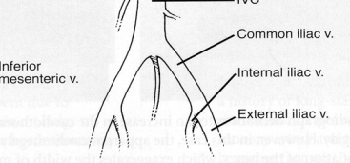
Recommandation of Iliac Interventions
►
Common, External and internal.
Iliac diameters: 6-12 mm
Start small, aim big: most commonly ruptured artery
Balloon-expandable stent for calcified lesions
Optimize outflow
Do not use self-expandable stents to treat aortic bifurcation disease
Do not stent across the CFA : flexible site

Slide 73
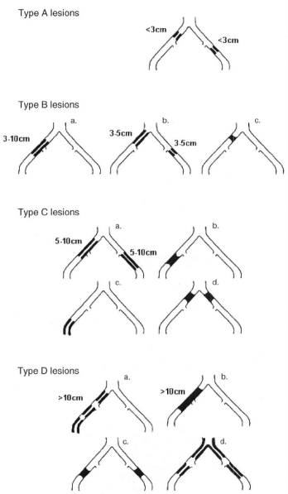
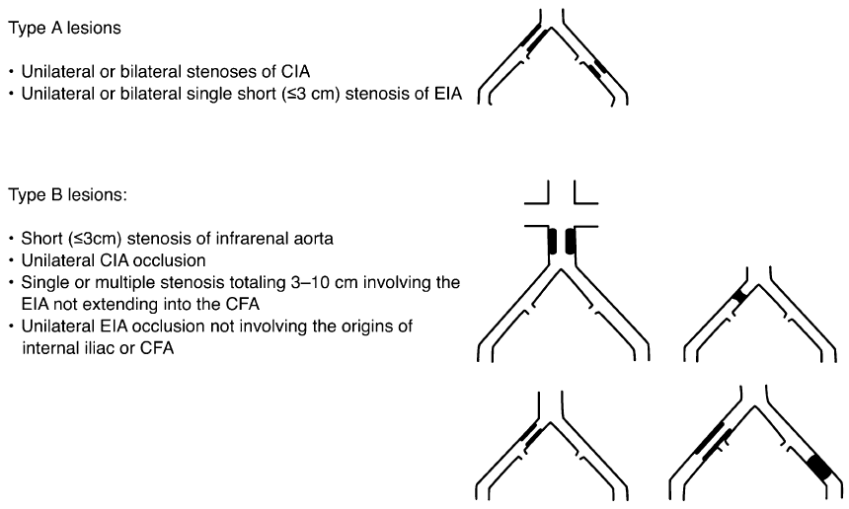
►
TASC 2000 and TASC II 2007

Slide 74
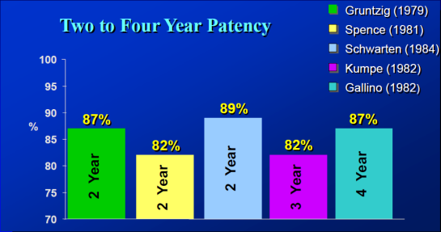
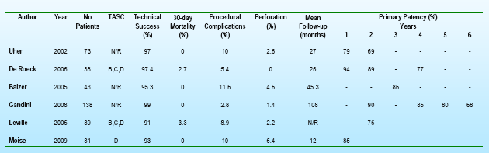
Endovascular Result of Iliac Lesion
►

Slide 75
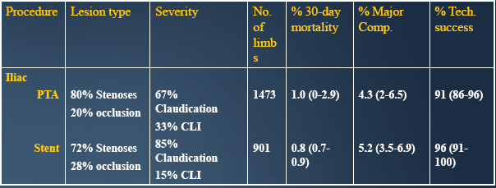
Iliac Intervention
; complicaton & success rate
►
Kandarpa et al. J Vasc Intev Radiol. 2001;12:683-95

Slide 76
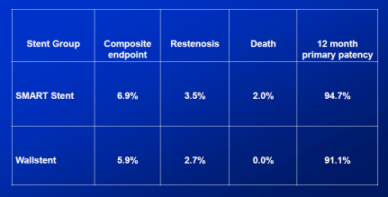
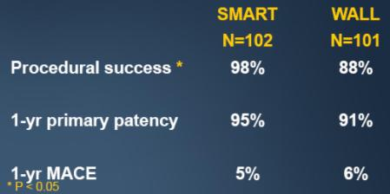
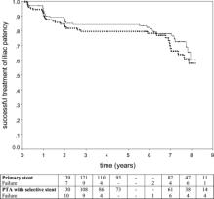
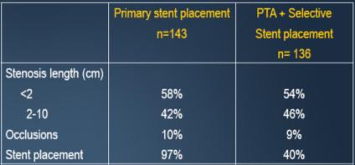
The Cordis Randomized Iliac Stent Project-US(CRISP-US) Trial
►
Ponec D et al. J Vasc Interv Radiol. 2004;15(9):911-8
The Dutch Iliac Stent Study
Klein WM et al. Radiology. 2006;238(2):734-44

Slide 77
Recommedation of Iliac Lesion
►
High procdeural success rate (90%)
Excellent long-term patency (>70%)
Factors associated with a poor outcomes
  Long segment occlusion
  Multifocal stenoses
  Eccentric calcification
  Poor runoff

Slide 78
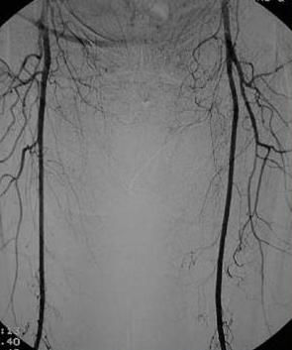
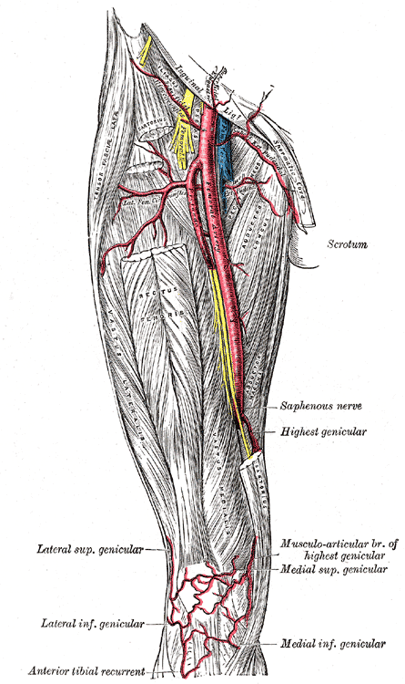
Femoral arteries and anatomy
►
Common, Superficial and
Deep femorals.
Femoral diameters: 5-8 mm

Slide 79
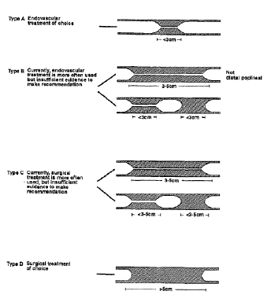
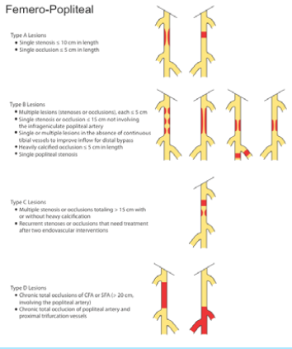
TASC 2000 and TASC II 2007
►

Slide 80
►
Treating more complex lesions
TASC 1 (2000) |  | TASC II (2007)
Stenosis <3cm | A | Stenosis ≤10cm Occlusion ≤5cm
Stenosis 3-5cm Occlusion <3cm | B | Stenosis/occlusion ≤15cm Calcified occlusion ≤5cm Single popliteal stenosis Multiple lesions, each ≤5cm
Stenosis/occlusion >5cm Multiple stenosis/occlusions 3-5cm | C | Stenosis/occlusion >15cm Recurrent restenosis
Occlusion >5cm | D | Occlusion >20cm involving Pop Popliteal occlusion

Slide 81
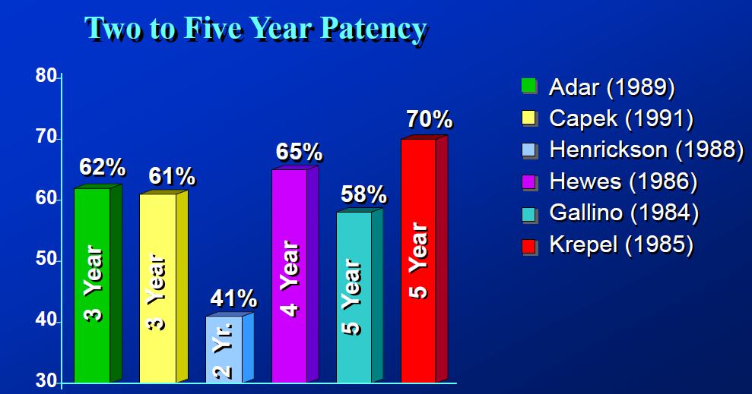
Result of Femoropoliteal PTA
►

Slide 82
Summary of 3 Randomized Trial
►
Lesions | ABSOLUTE | FAST | RESILIENT
Length | 9.5cm | 4.5cm | 6.0cm
Occlusions PTA/Stent | 32/37% | 25/37% | 19/17%
PTA crossover | 32% | 11% | 40%
12 mo primary patentcy rate
PTA | 37% | 61% | 38%
Stent | 63% | 68% | 80%

Slide 83
Challenges of F-P Revascularization:
A Heterogenous Disease Entity
►
Unfavorable Anatomy
  - Slow flow and dynamics: In-flow and run-off
  - Two bifurcations/articulations
  - Unique Vessel Forces: Flexion, compression, torsion, pisitoning
Diffuse Disease
  High incidence of occlusive disease
  Complex lesion morphologies (ostial lesions/Ca⁺⁺)
  Competitive flow via PFA
  About 30cm long
Relatively poor endovascular results
: Bypass surgery is the Gold standard ?

Slide 84
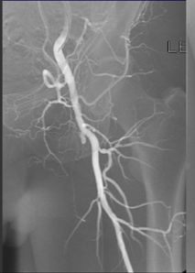
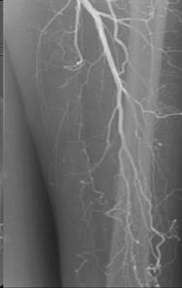
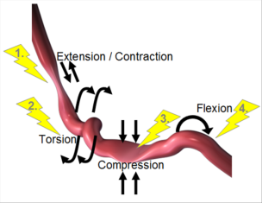
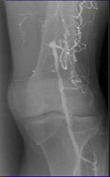
SFA: Longest Vessel in the Body
►
Worst
Ostial involvement
Long & diffuse disease
Large plaque burden
CTO with natural collateral (PFA) …..both blessing & curse
Concomitant inflow & outflow disease
HEAVILY calcified
Unique vessel forces
  Restenosis
  Stent fracture

Slide 85
The Ideal SFA Lesion is Rare
►
PTA alone

Slide 86
Intraluminal vs. Sub-intimal
►

Slide 87
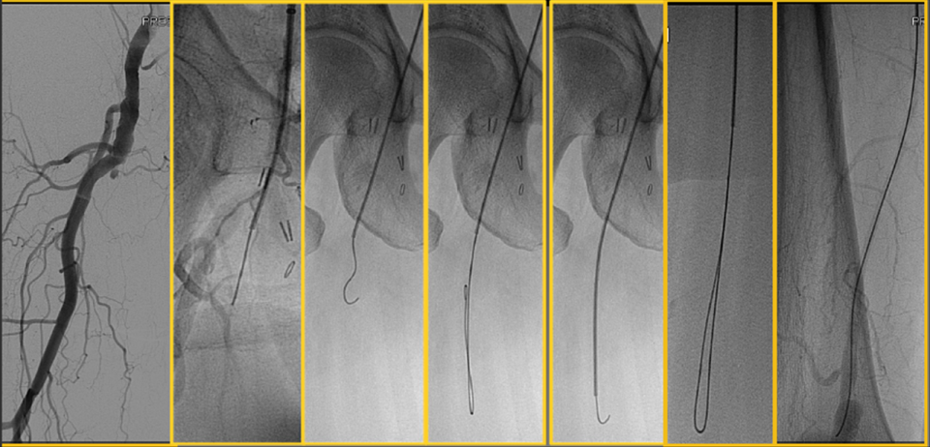
Standard SFA Subintimal Technique
►
Notes:
Prolapse wire through occlusion
Track low profile catheter over wire for support & direction
Avoid contrast staining
Redirect wire tip towards distal point of reconstitution
Exits true lumen 80% cases
Prolapse wire through occlusion
Track low profile catheter over wire for support & direction
Avoid contrast staining
Redirect wire tip towards distal point of reconstitution
Exits true lumen 80% cases

Slide 88
►
Angioplasty Attempts and Immediate Failures
Of the 224 patients allocated to angioplasty, 216 underwent
attempted angioplasty
Of these, 43 (20%) of attempted angioplaty patients were considered immediate failures
Nowdays, there have been a lot of improvements in techniques and devices.
However, the failure of re-entry has always been a problem.
Lancet 2005;366:1925-34
Notes:
-In BASIL trial of 2005, 20% of attempted angioplasty patients were considered immediate failures.
- major causes of immediate failure were that the lesion crossed subintially, but could not be re-entered. Or that lumen could not be crossed with GW
- Nowdays, there have been many improvements in techniques and devices. However, the failure of re-entry has always been a problem.

Slide 89
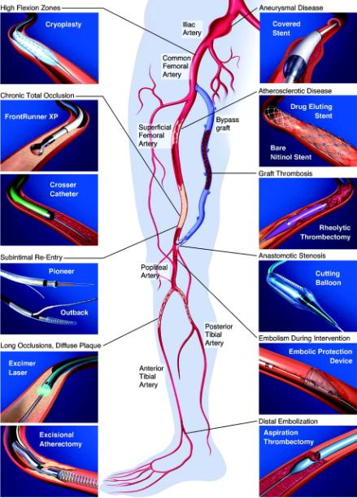
►
New technologies for lower extremity revascularization
Drugs
• Subintimal Angioplasty
• Bare Stents
• Covered stents
• Drug eluting Stents
• Drug eluting balloon
• Bioabsorbable Stents
• Brachytherapy
• Cryoplasty
• Cutting balloon
• Photodynamic therapy
• Debulking -artherectomy
Rogers, J. H. et al. Circulation 2007;116:2072-2085
Notes:
89

Slide 90
To solve passage or reentry problems
►
Reentry catheter
Retrograde approach
Bypass surgery
Notes:
-There are some solutions to solve passage or re-entry problems
- Reentry catheter, retrograde approach, bypass surgery

Slide 91
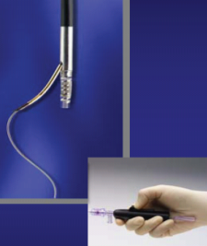
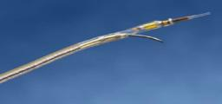
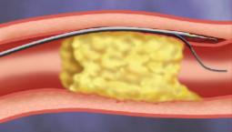
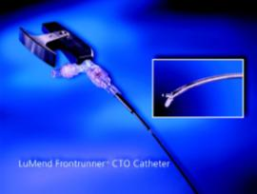
Currently available device for recanalization
►
Outback LTD reentry catheter, Pioneer cath.
Frontrunner device
Advantages
a. Time saving
b. Decrease radiation
c. Controlled reentry
d. Safe recanalization
Disadvantages
a. cost problem
b. require experience
But unnecessary in almost all of the cases

Slide 92
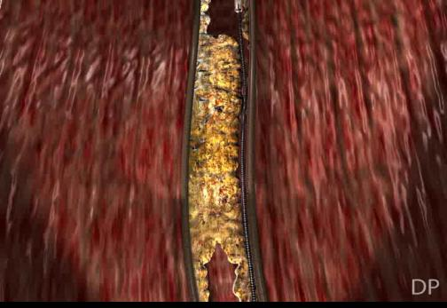
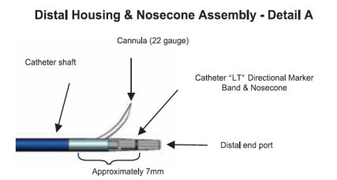
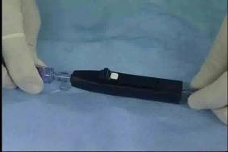
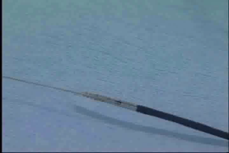


►
Notes:
-in the cannula part, there is a radioopaque LT directional marker. So, it is possible to change cannula direction using LT marker
- this is lateral view, this is AP view and PA view.

Slide 93


Main issues
BTK / Infrapopliteal arteries
►
Popliteal, and Trifurcation (tibial & peroneal): 2-4mm
Not Uncommon
DM Occlusive Disease is more common in BTK
Occlusion more common than stenoses: 2/3
Critical Limb Ischemia > claudication
Multilevel obstruction
Need distal bypass surgery/major amputation
Poor prognosis
Low flow arteries
Long segment disease: 50% >10cm
Few randomized study
Not good long term results
No especially designed stent
- 95% PTA,
- 35% Stent,
- 30% thrombolysis
Savy balloon, long balloon

Slide 94
ASO vs DM
►
특징 | 신경병성 족부 궤양 (neuropathic ulcer) | 허혈성-신경병성 족부궤양 (neuro-ischemic ulcer)
통증 동맥 맥박 궤양의 모양 궤양의 위치 피부 경결 감각 소실 혈류 발등의 정맥 발의 체온 족부 변형 발의 피부 색깔 | 없음 정상 "Punched-out lesion" 발바닥 혹은 발의 가장자리 있다 있다 증가 확장 따듯하다 있다 붉다 | 있음 소실 불규칙한 변연 주로 발가락 없다 혹은 흔치 않다 다양함 감소 수축 차다 없다 창백 혹은 청색증
By Courtery of Prof. WY Kim

Slide 95


►

Slide 96


►

Slide 97

CLI : disease pattern
►
~ 50% : long occlusion (>10cm)
~ 30% : three-vessel occlusive lesions
~ 50% : at least one patent distal foot vessel
Graziani et al. Eur J Vasc Endovasc Surg 2007

Slide 98





Why PTA for Complex BTK lesions?
- Angiosome -
►
ATA PA PTA

Slide 99

Why PTA for Complex BTK lesions?
- Angiosome -
►

Slide 100


Which artery or arteries should be treated?
►
Which of the crural arteries is most beneficial to target to recanalize
  Which vessel is patent lower in the leg/foot
  Site of ulceration
Location | Artery that should be peferentially revascularized
Heal wounds | Peroneal or posterior tibial artery
Plantar foot wounds | Posterior tibial artery
Lateral ankle wounds | Peroneal artery
Dorsal foot wounds | Anterior tibial artery
C. Setacci et al. J Cardiovasc Surg 2010;51:223-31

Slide 101
Angioplasty of BTK arteries; long term FU and factors influencing clinical outcomes
►
Retrospective analysis
To evaluate clinical and morphological factors
1445 limbs in 1268 pts
89% of intended-to-treat arteries
Mean number of treated arteris; 1.77 artery/limb
No of patent arteries post-PTA: most important factor affecting LS
  0 artery: 56.4% of PLS at 1yr
  1 artery: 73.1% of PLS at 1yr
  2 artery: 80.4% of PLS at 1yr
  3 artery: 83% of PLS at 1yr
Every effort should be made to perform PTA for as many arteries as possible, even if TASC D type, to improve clinical outcome.
Peregrin JH, Koznar B, Kovác J, Lastovicková J, Novotný J, Vedlich D, Skibová J. PTA of infrapopliteal arteries: long-term clinical follow-up and analysis of factors influencing clinical outcome. Cardiovasc Intervent Radiol. 2010 Aug;33(4):720-5. Epub 2010 May 11.

Slide 102

Revascularization Strategy in DM c CLI
►
The best therapy for Limb Slavage in DM c CLI is at least one direct flow to the foot
First, initial intraluminal crossing attempt.
Subinitmal technique only when lesion becomes uncrossable (long CTO lesion)
Half stiff J shape

Slide 103
How different BTK intervention are
►
Angioplasty is the mainstay of treatment
Subintimal passage is more frequent
Reentry catheter is no appropriate: many alternative techniques
Aim of treatment is limb salvage
  - Prevent major amputation & promote wound healing
  - Longterm patency is not crucial

Slide 104



Subintimal Angioplasty
►
MEET, 2010, By Amman Bolia

Slide 105
Tools for BTK intervention
►
Guidewires for BTK CTO
Balloons
  Monorail coronary balloons
  Dedicated BTK-balloons (overthewire도 많다)
CTO devices
  Guidewires for BTK-arteries
  Alternative Access-sites
Alternative balloon-technology
  Cutting-balloon
  Scoring-balloon
  Cryotherapy
Atherectomy
  Directional atherectomy
  Rotational atherectomy
Standard-guidewires
  Hydrophilic tipped guidewires
  0.014 PT2, PT Graphics (Boston Scientific)
  0.014 Shinobi, 300cm (Cordis)
  0.018 V18-control (Boston Scientific)
  0.035 Terumo (Terumo)
Coronary 0.014 CTO guidewire
  Miracle guidewire (Asahi, Abbott)
  Confienza guidewire (Asahi, Abbott)

Slide 106

Discrepancy between limb salvage and primary patency in BTK arteries
►
Temporally increasing blood flow effects in eradicating infection and healing ulcer
Foot tissue healing reduces O2 demand
Less blood flow is enough to maintain tissue integrity
Gradual narrowing after PTA allows sufficient time for new collaterals
Ferraresi R, Centola M, Ferlini M, Da Ros R, Caravaggi C, Assaloni R, Sganzaroli A, Pomidossi G, Bonanomi C, Danzi GB. Long-term outcomes after angioplasty of isolated, below-the-knee arteries in diabetic patients with critical limb ischaemia. Eur J Vasc Endovasc Surg. 2009 Mar;37(3):336-42. Epub 2008 Dec 27.
Romiti M, Albers M, Brochado-Neto FC, Durazzo AE, Pereira CA, De Luccia N. Meta-analysis of infrapopliteal angioplasty for chronic critical limb ischemia. J Vasc Surg. 2008 May;47(5):975-981. Epub 2008 Apr 18.

Slide 107




►
Baseline
Immediate
2-year

Slide 108
Goal of Infrapopliteal Intervention
►
Relieve pain
Heal ischemic ulcers/wounds
Prevent limb loss

Slide 109
Summary
►
BTK lesion: diffuse, long segment occlusion
At least one direct blood flow to the foot => revascularization of diseased artery feeding to wound or ischemic region
Angioplasty is the mainstay treatment
More aggressive revascularizations are necessary for limb salvage c alternative techniques
Stenting of focal lesions improves clinical outcomes

Slide 110
Overview of Management
►

Slide 111
Arterial Reconstruction Procedure
Bypass
Interposition graft
Endarterectomy
Patch angioplasty
Thrombectomy
  mechanical
  pharmacologic
Embolectomy
Bypass
Interposition
graft
By Courtery of Prof. WY Kim

Slide 112
Comparison of arterial reconstructive techniques
►
Stenosis Vs.
Occlusion
Length of
lesion
Vessel
caliber
Suitable
site
Angioplasty
Either
Short segment Better
> 2 mm
Any site
Bypass
Either
Not a
Factor
> 2 mm
Any site
Endarterectomy
Stenosis
better
Short segment
Better
> 5-6 mm
Carotid, femoral
bifurcations
Aortic branching
PTA/stenting
Stenosis
better
Short segment
Better
> 4 mm (?)
Distal abd aorta
Iliac, Renal,
Carotid, BTK, BTA(?)
By Courtery of Prof. WY Kim (Modified)

Slide 113
Angioplasty
►

Slide 114


Angioplasty
►
Graft angioplasty

Slide 115


Angioplasty
►
Pericardial patch angioplasty

Slide 116


Angioplasty
►
Vein patch angioplasty
By Courtery of Prof. WY Kim

Slide 117
Bypass
►

Slide 118



Bypass
►

Slide 119
Byass Material
►
Ipsilateral great saphenous vein (GSV)
Contralateral great saphenous vein
Arm vein
Small saphenous vein (SSV)
Femoral vein
Saphenous vein branch
Cryopreserved homograft
Human umbilical vein PTFE(polytetrafluoroethylene) graft
Dacron graft
Prosthetic graft + vein patch/cuff
Prosthetic graft + heparin
Prosthetic graft + endothelial cell
Modified graft design

Slide 120


Bypass with Vein Graft
►
Reversed vein
In situ vein
Non-reversed translocated vein
Spliced vein
By Courtery of Prof. WY Kim

Slide 121


Bypass with Vein Graft
►
Inframalleolar bypass
By Courtery of Prof. WY Kim

Slide 122
Causes of Vein Graft Failure
►
Early (<1mo): Technical failure, judgment failure
Intermediate (3-24 mo): Intimal hyperplasia
Late (> 24 mo): Progression of atherosclerosis

Slide 123


Graft
►
Dacron® graft
Goretex® graft

Slide 124

Bypass with Artificial Graft
►
Femoropopliteal bypass

Slide 125


Bypass with Artificial Graft
►
Femoro-anterior tibial bypass
By Courtery of Prof. WY Kim

Slide 126



Bypass with Artificial Graft
►
Aorto-Bi-Fermoal bypass
By Courtery of Prof. WY Kim

Slide 127


Bypass with Artificial Graft
►
Extra-anatomical bypass
Fem-fem crossover bypass
Axillo-bifemoral bypass

Slide 128
Endarterectomy
►

Slide 129


Endarterectomy
►
Carotid
By Courtery of Prof. WY Kim

Slide 130


Endarterectomy
►
Aortic
By Courtery of Prof. WY Kim

Slide 131
PTA & Stent
►

Slide 132



Angiogram
►
Routine Flurography
DSA(digial subtraction
angiography
Roadmap

Slide 133


Positioning the patient
(for a right-handed operator)
►

Slide 134
Approach
►
Femoral (90 %)
  Antegrade
  Retrograde
Brachial
Radial
Popliteal
Direct puncture

Slide 135
Unit
►
Inch - Wire
French - Sheath, Catheter
mm - Balloon, Stent
1mm = 0.039 inch = 3F
25.2mm = 1 inch

Slide 136
►
Wire(inch): Outer wall

Slide 137

►
.035
.018
.014

Slide 138
►
Catheter(French):Outer wall
15F = 5mm
16F = 5.333mm
17F = 5.667mm
18F = 6mm
19F = 6.333mm
20F = 6.667mm
21F = 7mm
22F = 7.333mm
23F = 7.668mm
24F = 8mm

Slide 139
Classification of Catheter
►

Slide 140

Catheter(French):Outer wall
►
Diagnostic catheter: flushing/selective
Guiding catheter:

Slide 141

All Information on the Hub..
►
1- PSI (max)
2-French size
3-Shaft length (usable)
4-GW accept.

Slide 142


Choosing a Catheter Shape
►
…depends on the vessel angulation.

Slide 143
►
Sheath(French): Inner wall

Slide 144
Classification of Catheter
►

Slide 145

Sheath(French): Inner wall
►

Slide 146
►
Balloon(mm): Outer wall
Stent(mm):Outer wall

Slide 147


Balloon(mm): Outer wall
►

Slide 148




Stent(mm):Outer wall
►
Balloon expandable Self expandable

Slide 149
Case – SFA short CTO
►
Lt SFA Focal CTO: subintimal dissection

Slide 150


►

Slide 151
Case – SFA – Long CTO
Outback case
►
Lt SFA Long CTO: Outback

Slide 152






►
Lower ext. CT angio (10/02/26)

Slide 153


Before & After
►

Slide 154
Hybrid
►

Slide 155


Hybrid
►
Bypass operations
Ilio-femoral
Femoro-femoral
crossover
Left femoro-
popliteal
By Courtery of Prof. WY Kim

Slide 156



Role of Simple and Complex Hybrid Revascularization proceudures
►
Dosluoglu HH, Lall P, Cherr GS, Harris LM, Dryjski ML. Role of simple and complex hybrid revascularization procedures for symptomatic lower extremity occlusive disease. J Vasc Surg. 2010 Jun;51(6):1425-1435.e1.

Slide 157
Case Presentation
►
Both CFA angioplasty (Rt: Goretex patcha angioplasty, Lt: Endoarterectomy)
Both SFA PTA Stent

Slide 158


Preop.
►

Slide 159

Op. Field
►

Slide 160

Endovascular Procedure
►

Slide 161

Op. Field at 2nd Op.
(Right Side)
►

Slide 162
Case Presentation
►
Thrombosis of Lt DFA and SFA after SFA Stent
  => Thrombectomy + Endarterectomy of Lt CFA + CFA DFA angioplasty +

Slide 163


111101-lowerCT
►

Slide 164



111101-lowerCT
►

Slide 165

CFA: Atheroma
►

Slide 166

DFA & CFA: Angioplasty
►

Slide 167

DFA & CFA: Angioplasty
►

Slide 168
III. Consideration
►

Slide 169
►
Why We Should Learn Endovascular Treatment?

Slide 170

Cardiovascular Surgeon with Balance
►
Surgery
Endovascular

Slide 171
Endo Vs Surgery POAD Volume (1997-2004) in the US
►
Notes:
171
171

Slide 172
►
New Devices & New Concepts
Nano Technologies

Slide 173


►
Translational Technologies in EVAR:Multimodality
JOHN W. KARANIAN, PHD; NADINE ABI-JAOUDEH, MD; Translational Technologies in EVAR:Multimodality Interventions. Endovascular toady 2009;March:15-18

Slide 174

►
Nano and the Future of Endovascular Medicine
REBECCA TAYLOR, MS; JAMES J. NORMAN, PHD; CHELSEY SIMMONS, BS Nano and the Future of Endovascular Medicine Endovascular toady 2009;March:27-

Slide 175
►
Study of Endothelial Dysfunction
Prevention

Slide 176

Endothelial Cell Dysfunction
►
Maintaining the vascular tone: Vasodilation and Vasoconstriction
Tousoulis, et al., Heart 2005; 91: 353-358

Slide 177
IV. Conclusion
►

Slide 178









►
Endo. & OSR & Hybrid
By courtesy of Dr. Park (Kae Hyun)
sick
Endo
hybrid /
integrated
approach
PATIENT
healthy
open repair
easy
difficult
ANATOMY

Slide 179




What is in Hybrid room?
►
Stationary Imaging System
Light Source
Inventory
Anesthetic Unit
USG
3D Workstation
Air Filter System
IVUS

Slide 180









Where?
►
Hybrid-room
Cath-room
Operation-room
Notes:
It depend on the operator who perform TEVAR:
Recently, a hybrid-room has been made in some domestic hospital.
It depends on the operator where to perform – in the cath-room or in the operation room.
Recently, a hybrid-room for hybrid-procedure has been made in a few domestic hospital.

Slide 181
Comparison bet. OR and Angio. Suite
►
 | C–Arm based OR OEC9800 with Vascular Program | Angio Suite (INNOVA system)
OR Time Controlled by | Anestheologist or Not at Local Anes. | IR or IC
Image | Low Quality Limited Time 12 inch | High Quality Longer Time 9, 12, 14, 12*16 inch
Table | Limited Sliding Perfomance | Sliding Table without Tilting and Bending Function
Space | Congested | Relatively Better
Clean Room | Laminar Flow | Air Filter System
Anestheology | Friendly or Not at Local Anes. | Hostile and Limited Help
Inventory | Limited | Diverse
Characteristics | Open Friendly | Endo Friendly

Slide 182
Toward Endovascular World
►
By courtesy of Dr. Kim (Jang Yong)
Vascular
Cardiac
Endovascular abdominal aneurysm repair
Endovascular thoracic aneurysm repair
Hybrid arch reconstruction
Fenestrated and branched engrafting
Endovascular repair of coarctation of the thoracic aorta
Peripheral vascular stenting
Hybrid treatment for PAOD
Endoleak coiling
Hybrid treatment for acute thrombotic syndrome in mesentery and limbs
Carotid artery stenting
Transfemoral aortic valve replacement
Trans-subclavian aortic valve replacement
Transapical aortic valve replacement
Endovascular mitral valve repair
Transpulmonary valve replacement
Transapical neochord replacement for mitral valve repair
Hybrid Maze procedure
Atrial septal defect with septal occluder
Ventricular septal defect with septal occluder
Hybrid coronary revascularization with coronary angiogram
Atrial fibrillation/Flutter ablation
Carotid artery stenting/carotid endarterectomy
CABG procedures
Minimal invasive aortic valve /mitral valve procedures
Hybrid therapies for congenital heart diseases
Pacemaker / AICD implantation
Neurovascular
Orthopedic/Trauma

Slide 183




Near Future
►

Slide 184


►
Endo. & OSR & Hybrid
By courtesy of Dr. Park (Kae Hyun)
sick
EVAR
hybrid /
integrated
approach
PATIENT
healthy
open repair
easy
difficult
ANATOMY

Slide 185
Human Technology =>
Human Philosophy
►
Certainly, our patients have benefited greatly from new technologies, devices, and cardiovascular treatment strategies, and these are integral to improving outcomes, but they do not ensure a successful cardiovascular center of excellence.
The creation of a true multidisciplinary team approach is at the very core of the center of excellence concept.
Perhaps when creating any center of excellence, the first technology to get right is the “human philosophy.”
Establishing aPeripheral VascularCenter of Excellence. DAVID E. ALLIE, MD; CHRIS J. HEBERT, RT, R-CIS; AND CRAIG M. WALKER, MD. FEBRUARY 2005 I ENDOVASCULAR TODAY I 41

